Slide 1

DEVELOPMENTAL DISORDERS
Chapter C.4
ENURESIS
Alexander von Gotard
DEPRESSION IN CHILDREN AND
ADOLESCENTS
Companion PowerPoint Presentation
Adapted by Julie Chilton

Slide 2

The “IACAPAP Textbook of Child and Adolescent Mental Health” is available at the IACAPAP website http://iacapap.org/iacapap-textbook-of-child-and-adolescent-mental-health
Please note that this book and its companion powerpoint are:
· Free and no registration is required to read or download it
· This is an open-access publication under the Creative Commons Attribution Non- commercial License. According to this, use, distribution and reproduction in any medium are allowed without prior permission provided the original work is properly cited and the use is non-commercial.

Slide 3


Enuresis
Outline
Definition and classification
Epidemiology
Clinical presentations
Etiology and risk factors
Comorbidity
Diagnosis
Treatment
Notes:
By the end of this presentation, you should understand the following about Enuresis in children and adolescents

Slide 4

Enuresis
The Basics
Very common
Occurs worldwide at same rate
7 year olds
  10% at night
  2-3% during the day
Adolescents
  1-2% at night
  <1% during the day
Vast majority are functional
20-40% comorbid disorders
Most treated with counseling and CBT
Notes:
Enuresis constitutes a very common group of disorders in childhood that
occur world-wide at approximately the same rate. 10% of all 7-yearolds,
wet the bed at night and 2% to 3% during the day. Despite a high
remission rate, still 1% to 2% of all adolescents are affected by nocturnal enuresis
and less than 1% by daytime wetting. The vast majority of elimination disorders
are functional, i.e., not due to neurological, structural or medical causes (von
Gontard & Neveus, 2006).
Enuresis is associated with emotional distress in both children and parents,
which is reversible once children become dry. Achieving continence is therefore
the main goal of treatment and will lead to an improvement of self-worth and
self-confidence (Longstaffe et al, 2000). On the other hand, 20%-40% of all
children with enuresis have additional, comorbid psychological disorders, not only
externalising conditions such as attention deficit hyperactivity disorder (ADHD)
and oppositional defiant disorder (ODD) but also internalising disorders such as
depression. These comorbid conditions require separate assessment and treatment –
in addition to the symptom-oriented treatment of the child’s elimination disorder.
Most types of enuresis can be treated effectively with counselling and
cognitive-behavioural approaches but some may require additional medication.
These therapies can in most cases be provided in primary care outpatient settings
– provided that they are based on a correct diagnosis and that child and parents
are given adequate professional care with sufficient time. The aim of this chapter is
to provide a practical approach to the assessment and treatment of children with
enuresis that can be implemented in different settings even in those with limited
resources.
James Joyce wet his bed.
The first page of Joyce’s
Portrait of the Artist as a
Young Man contains the
following: “when you first wet
the bed it is warm and then
it gets cold. His mother put
on the oilsheet. That had the
queer smell” (Gill, 1995).
Portrait by Robert Amos
www.robertamos.com

Slide 5
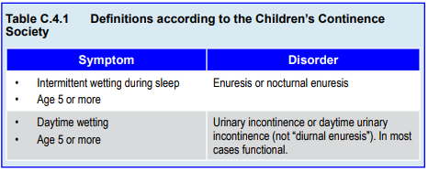
Enuresis
Definition
Notes:
Enuresis is defined by both ICD-10 (World Health Organisation, 2008)
and DSM-IV-TR (American Psychiatric Association, 2000) as involuntary (or
even intentional) wetting in children 5 years of age or older after organic causes
have been ruled out. The wetting must have persisted for at least three months to
be considered a disorder. According to ICD-10, enuresis is diagnosed if wetting
occurs two times a month in children under 7 years of age and once a month in
children 7 years and older. The criteria according to DSM-IV is less precise: the
voiding must occur at least twice per week or else must cause clinically significant
distress or impairment in social, academic (occupational) or other important areas
of functioning. Both ICD-10 and DSM-IV-TR describe nocturnal, diurnal or
combined enuresis – no other subtypes are included. Also, ICD-10 excludes a
diagnosis of enuresis if other psychiatric disorders are present. Both ICD-10 and
DSM-IV-TR are outdated and do not reflect newer research findings in this field.
Unfortunately, the proposed DSM-5 criteria are not very useful and may even
constitute a step back from DSM-IV. The Children’s Continence Society (ICCS)
(Neveus et al., 2006) has proposed newer, more practical suggestions, which are
being revised in 2012. The aim is to provide simple, descriptive clinical terms that
can be used in all settings world-wide.
According to the ICCS criteria, enuresis denotes an intermittent (i.e.,
not continuous) wetting during sleep in children after their fifth birthday. The
term nocturnal can be added for clarity (i.e., enuresis and nocturnal enuresis are synonyms). Daytime wetting is termed urinary incontinence, which can be organic
(structural, neurogenic or due to other physical causes) or functional. As the vast
majority of cases are functional, most children with daytime wetting would be
considered to have some form of functional urinary incontinence. According
to these criteria, the term diurnal enuresis is obsolete and should be avoided. If
children wet during sleep and during the day, they would receive two diagnoses:
enuresis and urinary incontinence.

Slide 6
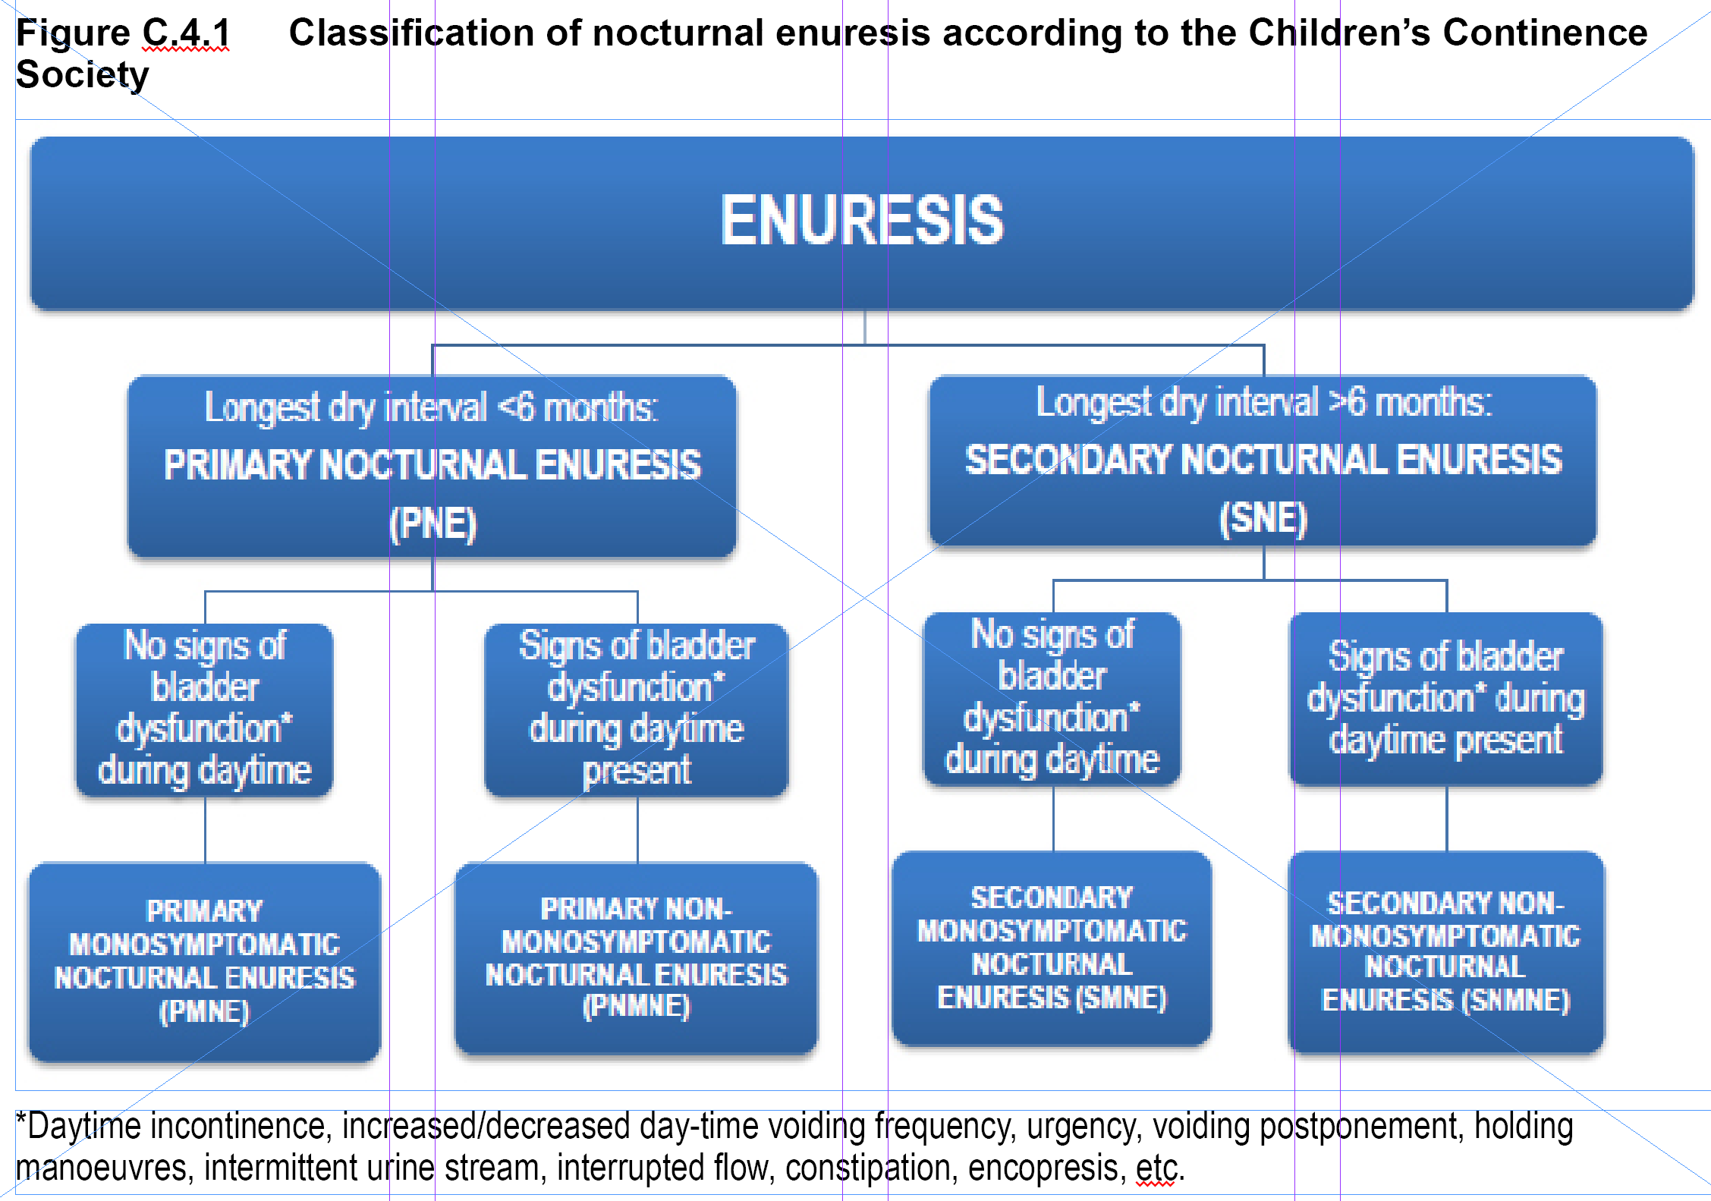
Notes:
The classification of enuresis is simple. Only two aspects need to be
considered: the longest dry period and if lower urinary tract symptoms are present:
• Primary enuresis means that the child has been dry for less than 6 months (or
not at all)
• Secondary enuresis means that a relapse after a dry period of at least 6 months
has occurred.
The dry period can occur at any age; also, it does not matter if it came about
spontaneously or was achieved by treatment. This distinction is important because
children with secondary enuresis have experienced stressful life-events (such as
separation of parents, birth of siblings, etc.) more often and have higher rates of
comorbid psychiatric disorders (Järvelin et al, 1990; von Gontard et al, 2011b).
These issues have to be considered in assessment and treatment, otherwise the
treatment of primary and secondary enuresis is exactly the same.
The presence of lower urinary tract symptoms is more important as it
carries implications for treatment. Children who wet during sleep and do not have
daytime symptoms suggesting disturbances of bladder function are suffering from
monosymptomatic enuresis. In other words, they wet at night but bladder storage
and emptying is completely normal (i.e., children go to the toilet 5-7 times during
the day, do not postpone micturition with the use of holding manoeuvres, do
not experience urge symptoms and can empty their bladders without problems).
In these cases, treatment can focus on the wetting episodes during sleep without
further preliminary procedures.
Children who have lower urinary tract symptoms and may have
gastrointestinal symptoms, such as constipation and soiling, have nonmonosymptomatic
enuresis. In non-monosymptomatic nocturnal enuresis, daytime
symptoms have to be treated first before addressing the night-time wetting. The
terms monosymptomatic and non-monosymptomatic are based entirely on history
and verified by voiding diaries, i.e., are based on clinical assessment only (von
Gontard & Neveus, 2006).

Slide 7
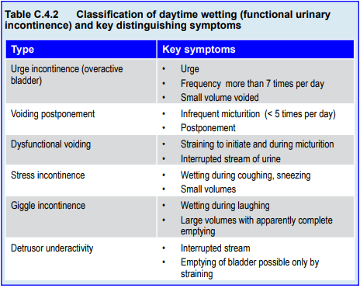
Enuresis
Outline
Notes:
The classification of daytime urinary incontinence is more complex. Most
types are functional – organic urinary incontinence is rare and can be due to
structural, neurogenic or other medical causes. The three main syndromes of
functional urinary incontinence are:
• Urge incontinence
• Voiding postponement, and
• Dysfunctional voiding.
Rare types include: stress incontinence, giggle incontinence, detrusor
underactivity and others. Each one of these types of urinary incontinence has
typical symptoms.
Urge incontinence or overactive bladder is characterised by urge symptoms,
increased micturition frequency and small voided volumes. By contrast, low
micturition frequency and postponement of micturition is typical in voiding
postponement. In both cases children employ holding manoeuvres to avoid wetting.
Dysfunctional voiding is a disorder of the emptying phase: instead of relaxing
the sphincter muscle, it is contracted paradoxically. Straining and an interrupted
urine stream are indicative of this disorder.
Stress incontinence is rare in children – in contrast to adults. Wetting
during coughing, sneezing (i.e., any increase of intra-abdominal pressure) and
small volumes are typical.
Giggle incontinence is characterised by wetting during
laughing, large volumes with apparently complete emptying. Detrusor underactivity,
a decompensation of the detrusor muscle, is marked by an interrupted stream;
consequently, emptying the bladder is possible only by straining.

Slide 8

Enuresis
Approximate Normal Values in Childhood
Micturition frequency: 5-7 times per day
Voided volumes: (age + one) multiplied by 30 ml
Notes:
As daytime urinary incontinence (and non-monosymptomatic enuresis)
can be identified by altered rates of micturition frequency and volume, it is helpful
to know the normal values (these are only an approximation), which are shown
in Table C.4.2. Normally, children void 5 to 7 times a day. The normal voided
volume in millilitres can be calculated by adding one to the age of the child and
multiplying by 30. For example a normal amount of micturition in an 8 year old
child would be: 8 + 1 = 9; 9 x 30 = 270 ml.
The aim of treatment is to achieve long-term continued and complete
dryness, not just a reduction of symptoms. Regrettably, this is not achieved in all
cases; for some children and families, however, a reduction in the frequency of
episodes can provide relief and has been shown to improve self-esteem (Longstaffe
et al, 2000).

Slide 9
Enuresis
Epidemiology of Enuresis
2-3 times more common than daytime urinary incontinence
1.5 to 2 times more common in boys
Prevalence decreases with age
  20% of 4 year olds
  10% of 7 year olds
  1-2% of adolescents
  0.3-1.7% of adults
Primary more common than secondary
Monosymptomatic twice as common as non-monosymptomatic
Daytime urinary incontinence 1.5 x more common in girls
Urge incontinence is most common
Voiding postponement second most common
Notes:
Daytime urinary incontinence is 1.5 times more common in girls than boys
(Bower et al, 1996; Hellström et al, 1990); 2%-3% of 7 year olds and less than 1%
of adolescents wet during the day (Hellström et al, 1990; Largo et al, 1978). In a
UK population study of 13,973 children, the rates of infrequent (less than 2 times
per week) and frequent (more than 2 times per week) were respectively: 13.6%
and 1.9% at the age of 4½; 7.8% and 1.5% at 5½; 9.7% and 1.0% at 6½; 6.9%
and 1.0% at 7½; 4.4% and 0.5% at 9½ years (Swithinbank et al, 2010). Different
trajectories can be identified:
• Children with chronic, persistent incontinence over many years
• Children with relapses and
• A group with a continuous spontaneous remission rate (Heron et al, 2008).
Urge incontinence is the most common, affecting 4% of 7-year olds,
especially girls (Hellström et al, 1990). Voiding postponement is the second most
common type based on clinical studies. Population-based rates for the other types
are lacking.

Slide 10
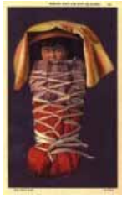
Enuresis
Worldwide Prevalence
4% Chinese children and adolescents 6-16 years old
8% Taiwanese children aged 6-11 years
15% Turkish children aged 5-7 years
15% children and adolescents in Saudi Arabia
17% of 7 year olds in Sudan
21% Ethiopian children and adolescents aged 6-15 years
(including daytime incontinence)
Notes:
The prevalence of nocturnal enuresis is comparable world-wide:
• 4.3% of Chinese children and adolescents aged 6-16 years (Liu et al, 2000)
• 8% of children aged 6-11 years in Taiwan (Chang et al, 2011)
• 14.9% of children aged 5-7 years in Turkey (Erdogan et al, 2007)
• 15% of children and adolescents in Saudi Arabia (Kalo & Bella, 1996)
• 17.4% of 7 years olds in Sudan (Rahim & Cederblad, 1986)
• 20.8% of children and adolescents aged 6-15 years in Ethiopia, including
daytime incontinence (Desta et al, 2007).
Variation in rates is probably due to different definitions, modes of
assessment and possible underreporting due to social desirability, particularly in
the Chinese and Taiwanese studies.
Only a few studies have reported daytime urinary incontinence. For
example, 16.6% of Korean children aged 5-13 years had overactive bladder, 4.5%
daytime incontinence and 6.4% enuresis (Chung et al, 2009).
In West Africa, children who
wet the bed were “treated” by
attaching a large frog to their
waist, and this apparently
frightened them into being
dry. Among the Navaho tribe,
one preferred treatment was
a ritual that required enuretic
children to stand naked over
a burning bird's nest, and this
was believed to produce a
cure of bedwetting because
birds did not soil their nests
(Houts, 2000).

Slide 11
Enuresis
Clinical Presentations:
Monosymptomatic Enuresis
Deep sleep and difficult arousal
Increased urine volume at night
Large wetted volumes
Normal bladder function during the day
Notes:
Typical symptoms of monosymptomatic enuresis are: deep sleep and difficult
arousal (Wolfish et al, 1997), increased urine volume at night (polyuria) with large
wetted volumes. The typical presentation is a child who is extremely difficult to
wake and who wets the bed with large amounts of urine. In contrast, bladder
function during the day is completely normal.

Slide 12
Enuresis
Clinical Presentation:
Non-Monosymptomatic Enuresis
Similar nighttime symptoms of monosymptomatic enuresis
Daytime urinary incontinence
(except wetting)
May also have UTIs, constipation and encopresis
Notes:
Children with a non-monosymptomatic enuresis have the same symptoms
but, in addition, have signs similar to those with daytime urinary incontinence
(except wetting). This means that some go to the toilet infrequently and postpone
micturition with holding manoeuvres, others have signs of urgency and frequency,
while others have to strain and the urine stream is interrupted. Also, urinary tract
infections (UTI’s), constipation and encopresis are possible.

Slide 13
Enuresis
Clinical Presentation:
Secondary Enuresis
Comorbid behavioral and emotional disorders
Stressful life events can cause relapse
  Separation or divorce of parents
  Birth of sibling
Otherwise, no difference from primary enuresis
Notes:
Children with secondary enuresis have higher rates of comorbid behavioural
and emotional disorders (von Gontard et al, 1999). A relapse can be precipitated
by stressful life-events such as separation or divorce of parents (Järvelin et al, 1990).
Otherwise, they do not differ from those with primary enuresis.

Slide 14
Enuresis
Clinical Presentation:
Urge Incontinence
High micturition frequency
  More than 7 x a day
  Short intervals in between
Urge symptoms
Incontinence with small micturition volumes
Holding maneuvers
Vulvovaginitis, perigenital dermatitis
Urinary tract infections
Notes:
Children with urge incontinence are characterised by:
• High micturition frequency (more than 7 times per day with short intervals
in between)
• Urge symptoms, sometimes with sudden, intensive urge
• Incontinence with small micturition volumes, increasing with tiredness, e.g.,
during the afternoon
• Holding manoeuvres such as contracting pelvic floor muscles, pressing thighs
together, holding abdomen, jumping from one leg to the next, sitting on
heel, squatting with the heel pressed against the perineum (curtsey sign)
• Vulvovaginitis, perigenital dermatitis
• Urinary tract infections

Slide 15
Enuresis
Clinical Presentation:
Voiding Postponement
Low micturition frequency: < 5 times a day
Postponement in certain situations
Holding maneuvers till wetting unavoidable
Stool retention, constipation, encopresis
Repeated straining
Intermittent and fractioned flow
Incomplete bladder emptying with residual urine and UTIs
Vesico-ureteral reflux
Notes:
Typical signs of voiding postponement are:
• Low micturition frequency (less than 5 times per day)
• Postponement of micturition in certain situations (school, play, reading,
television). With increasing postponement and fullness of bladder, holding
manoeuvres are instituted (as in urge incontinence) until wetting cannot be
avoided.
• Constipation and encopresis are common.
Voiding postponement is characterised by:
• Repeated straining at the beginning and during micturition
• Intermittent and fractioned urine flow
• Incomplete bladder emptying with residual urine and UTI’s
• Stool retention, constipation and encopresis
• Vesico-ureteral reflux.

Slide 16
Enuresis
Etiology and Risk Factors
Monosymptomatic enuresis: marked genetic component
Urge incontinence: marked genetic component
Secondary enuresis: genetic and environmental
Voiding postponement: mostly environmental
Notes:
Genetic and neurobiological factors interact with environmental influences
in the pathogenesis of elimination disorders. While some have a marked genetic
component (monosymptomatic enuresis and urge incontninence), in others both
genetic and environmental factors are involved (secondary enuresis), while some
are mostly environmentally determined (voiding postponement).

Slide 17
Enuresis
Etiology and Risk Factors: Enuresis
Genetically determined maturational disorder of the central nervous system
70-80% have affected relatives
Concordance rates: monozygotic > dizygotic twins
Most autosomal dominant inheritance
Loci on chromosomes 12, 13, 22
Neurological soft signs
Longer to complete motor tasks
Sleep architecture not affected
Mean latency = 3 hours
Notes:
Genetic and neurobiological factors interact with environmental influences
in the pathogenesis of elimination disorders. While some have a marked genetic
component (monosymptomatic enuresis and urge incontninence), in others both
genetic and environmental factors are involved (secondary enuresis), while some
are mostly environmentally determined (voiding postponement).
Enuresis is a genetically determined maturational disorder of the central
nervous system (von Gontard et al, 2001; 2011a); 70% to 80% of all children with
enuresis have affected relatives. The concordance rates are higher among mono than
di-zygotic twins (Bakwin, 1973). The recurrence risk for a child to be affected
by enuresis is 40 % if one parent and 70 % if both parents had been enuretic
(Bakwin 1973). Most cases are consistent with with an autosomal dominant mode of inheritance; only one third of cases are sporadic (von Gontard et al, 2001).
Several loci on chromosomes 12, 13 and 22 have been identified in linkage studies
– irrespective of the type of enuresis (von Gontard et al, 2001). Candidate genes
have not been identified yet. A genetic predisposition for enuresis remains life-long
and can be reactivated by risk factors, even in adulthood (Hublin et al, 1998).
Children with enuresis have more neurological “soft signs” and need longer
to complete motor tasks (von Gontard et al, 2006). In contrast, sleep architecture
is not affected. Enuresis occurs in non-REM sleep phases, i.e. it is not associated
with dreaming (enuresis during REM sleep is the exception). Enuresis occurs
predominantly in the first third of the night – some children even wet the bed 10
minutes after falling asleep. The mean latency is 3 hours (Neveus et al, 1999). This
explains why some children with enuresis wet even during daytime naps.

Slide 18
Enuresis
Main Mechanisms for Development
Increased urine volume in some
Circadian variation of antidiuretic hormone
Impaired arousal
Inhibition deficit of pontine micturition centre of brainstem
Type of toilet training has no effect
Psychosocial factors bigger role in secondary enuresis
Notes:
The main mechanisms responsible for the development of enuresis include:
• Increased urine volume (polyuria) affects some, but not all children. This
is associated with a circadian variation (but not lack) of the antidiuretic
hormone (Rittig et al, 1989).
• Impaired arousal is another important factor (Wolfish et al, 1997). In
standardised waking schedules with sounds of up to 120 decibels, only
9% of children with enuresis can be woken up – significantly fewer than
controls. This means that children with enuresis do not wake up when their
bladder is full.
• Finally, children have an inhibition deficit of the pontine micturition centre
of the brainstem. When the bladder is full during sleep, they are not able to
sufficiently suppress emptying (Koff, 1996).
In addition to local bladder dysfunction, the same factors are responsible for
the development of non-monosymptomatic enuresis.
Psychosocial factors modulate genetic and neurobiological risks in different
ways. The time of initiation and intensity of toilet training, for example, has
no effect on the development of enuresis (Largo et al, 1978; 1996). Psychosocial
factors play a minor role in primary enuresis, as the rate of psychological disorders
and risk factors is not increased (Fergusson et al, 1986; Feehan et al, 1990).
Children with secondary enuresis, however, have both higher rates of emotional
and behavioural disorders as well as stressful life events prior to the relapse (Järvelin
et al, 1990; Feehan et al, 1990). The age of school entry (5-6 years) is the most
common age for relapse while parental separation or divorce is the most important
life event (Järvelin et al, 1990).

Slide 19
Enuresis
Etiology and Risk Factors: Urinary Incontinence
OR > 3 if mother affected
OR > 10 if father affected
Positive linkage to chromosome 17
Urge incontinence: spontaneous contractions of detrusor
Giggle incontinence has genetic factor
Voiding postponement due to acquired habit or oppositionality
Notes:
Genetic factors play a role in daytime urinary incontinence as well. In a
population-based study of 8230 children, the odds ratio for daytime incontinence
increased by 3.28 if the mother and by 10.1 if the father was affected (von Gontard
et al, 2011a). Linkage studies demonstrate a positive linkage to chromosome 17
(Eiberg et al, 2001). Urge incontinence is caused by spontaneous contractions
of the detrusor during the filling phase of the bladder, which are not sufficiently
inhibited by the central nervous system (Franco, 2007). Genetic factors also play a
major role in giggle incontinence but not in the other types of incontinence.
Daytime continence is not influenced by early or intensive toilet training in
general (Largo et al, 1996; 1978). However, psychosocial factors do play a major
role in daytime incontinence (see section on comorbidity). Voiding postponement
can be due to an acquired habit or as one of many oppositional symptoms as part
of ODD (Kuhn et al., 2008).

Slide 20
Enuresis
Comorbidity: Enuresis
Psychological disorders 2-5 x greater in children with elimination disorders
Especially with secondary enuresis and non-monosymptomatic enuresis
Most common comorbidity: ADHD
Rates slightly higher with daytime incontinence
Also common:
  Separation anxiety
  Social anxiety
  Specific phobia
  Generalized anxiety
  Depression
  ODD
  Conduct disorders
  ADHD
Notes:
Overall, psychological disorders are 2 to 5 times more frequent in children
with elimination disorders. In summary, 20%-30% of children with enuresis,
20%-40% of those with urinary incontinence, and 30-50% with encopresis have
clinically relevant comorbid disorders (von Gontard et al, 2011b). Comorbidity
rates are highest in children with secondary enuresis – up to 40% in populationbased
and 75% in clinic-based studies (Feehan et al, 1990; von Gontard et al,
1999). Children with non-monosymptomatic enuresis have more comorbid
disorders than those with monosymptomatic enuresis (Butler et al, 2006).
ADHD is he most common comorbid disorder in enuresis. In a population
study of 1379 children aged 6 years, 9.4% had clinically relevant ADHD symptoms
compared to 3.4% of non-wetting children (von Gontard et al, 2011c). The rate of
ADHD in enuretic children presented to a paediatric hospital was 28.3%, compared
to 10.3% in a non-selected sample (Baeyens et al, 2006). Enuresis persisted longer
in children with ADHD – 2 years later, 65% were still enuretic compared to 37%
of controls (Baeyens et al, 2005). Enuresis in combination with ADHD is more
difficult to treat due to non-compliance. With alarm treatment, 43% of those with
comorbid ADHD were dry (versus 69% of those with enuresis alone) at 6 months
and only 19% (versus 66%) at 12 months. The rate of non-compliance was 38%
if both enuresis and ADHD co-existed (Crimmins et al, 2003).
Externalising disorders predominate but internalising conditions can also
occur. In a British population-based study of 8242 children at the age of 7½ years,
those with enuresis also suffered from separation anxiety (8.0%), social anxiety
(70%), specific phobia (14.1%), generalised anxiety (10.5%), depression (14.2%),
ODD (8.8%), conduct disorders (8.5%) and ADHD (17.6%) (Joinson et al,
2007).
Children with enuresis are not only afflicted with more comorbid disorders,
they are also more distressed and show more subclinical symptoms, which often
improve upon attaining dryness. Self-esteem can be affected and can improve under
treatment – irrespective of treatment success (Longstaffe et al, 2000). Also, quality
of life can be reduced by the enuresis (Bachmann et al, 2009). Both children and
parents can be distressed by the enuresis.
Daytime urinary incontinence
Comorbidity rates among children with daytime urinary incontinence
(30%-40%) are slightly higher than in children with enuresis (20%-40%) (von
Gontard et al, 2011b). In a population-based study of 8242 children aged 7 ½
years, externalising disorders were prominent with significantly increased rates of
ADHD (24.8%), ODD (10.9%) and conduct disorders (11.8%) (Joinson et al,
2006). In another population study, 36.7% of children with urinary incontinence
had ADHD symptoms, in comparison to 3.4% of dry children (von Gontard et al, 2011c). Adherence to treatment is lower in cases of urinary incontinence
and ADHD: only 68% became dry, compared to 91% of controls with urinary
incontinence without ADHD (Crimmins et al, 2003).
Children with urge incontinence have lower rates of comorbid disorders
than those with voiding postponement (36% vs. 59%) but higher than controls
(9%) (Kuhn et al, 2009). Children with urge incontinence predominantly have
internalising disorders while the most typical disorder in voiding postponement is
ODD (Kuhn et al, 2009). It would appear that comorbid disorders are a consequence
of wetting in urge incontinence while ODD seems to be the underlying problem
in voiding postponement. Much less is known about comorbidity in the other
types of incontinence.

Slide 21
Enuresis
Diagnosis
Standard:
History
48 hour frequency/volume chart
Questionnaires
Pediatric physical exam
Urinalysis
Child psychiatric screening/assessment
Sonography (if available)
If indicated:
Urine bacteriology
Uroflowmetry and pelvic floor EMG
Radiological exams
Invasive urodynamics
Cystoscopy
Notes:
Assessment and a careful diagnosis are the bases for successful treatment
– each subtype of enuresis and urinary incontinence responds best to its specific
treatment. Assessment also means building a relationship with the child and parents
that will become the foundation for the entire course of therapy. It is therefore
advisable to take plenty of time for the first consultation with child and parents.
More details on the diagnosis and treatment of all elimination disorders can be
found in von Gontard and Neveus (2006), which is still the most comprehensive
textbook on the topic, with both background information and practical procedures.
Most of the diagnostic process is based on simple, good clinical practice
that can be delivered in most primary care settings. The most important step is
a good and thorough history. The history will lead the clinician towards possible
diagnoses which need to be followed up and enable the exclusion of many other
conditions. An example of a detailed history with pertinent questions can be found
in Appendix C.4.1.
Each child should be examined physically at least once at the beginning
of treatment. It is essential that organic causes of incontinence are ruled out. A
full paediatric and neuorological exam is recommended. Children with daytime
incontinence may require several examinations in the course of treatment,
especially if UTI’s and other complications occur. For most children with enuresis,
especially with monosymptomatic enuresis, one exam will suffice.
At least one urinalysis (with a urine stick) is recommended to be sure
that no signs of bacteriuria and manifest UTI are present. This is especially
important in daytime urinary incontinence; it is usually negative in children with
monosymptomatic enuresis.
If available, sonography is a very useful, non-invasive tool. In addition to the
detecting structural anomalies of the urinary tract, sonography can give valuable
information regarding three functional changes:
• A thickened bladder wall (> 2.5mm) can be indicative of a hypertrophy of
the bladder wall as a sign of bladder dysfunction or it can be due to UTI’s
• Residual urine (>20ml) can be indicative of incomplete bladder emptying;
and finally,
• An enlarged rectal diameter of more than 25mm can be a sign of stool
retention and constipation.
However, even in Europe, sonography is not easily available in many
countries and thus not routinely performed in children with enuresis and urinary
incontinence. In complicated cases with recurrent UTI’s it is definitely indicated.
All other procedures are not routinely indicated. Uroflowmetry alone or
combined with pelvic floor EMG is required for the diagnosis of dysfunctional
voiding (Chase et al, 2011). So-called staccato (changes in flow rates) or fractioned
(complete interruption of flow) are typical, combined with contractions of the
pelvic floor. If not available, good clinical practice would be to listen and observe
a child during the emptying of the bladder: one can hear and observe the straining
as well as the waxing and waning of the urine stream.
All other, especially invasive, procedures should not be performed in
children with enuresis or functional urinary incontinence unless they are absolutely
indicated medically. Radiological and further urological investigations should be
avoided as they are in most cases not necessary and can harm the child.
Somatic causes of urinary incontinence must be excluded. These include
structural anomalies (such as epispadias, hypospadias, urethral valves, and other
malformations of the urinary tract), neurologic conditions (such as spina bifida
occulta, tethered-cord-syndrome, etc.) and other paediatric diseases (such as
diabetes insipidus, diabetes mellitus). Comorbid emotional and behavioural
disorders should be assessed in addition to the type of elimination disorder.

Slide 22
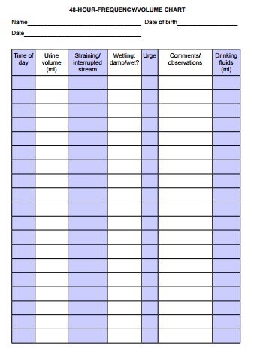
Notes:
The second most important step is a 48-hour frequency-volume chart.
Parents are asked to observe, record and measure over 48 hours when and how much
their child voids and drinks, as well as associated symptoms such as incontinence,
holding manoeuvres, etc. Parents can be given a simple plastic measuring cup
(which they will return at the next visit and that can be used many more times).
This chart gives essential information for the diagnosis. In urge incontinence, for
example, a micturition frequency of over 7 and small volumes (of 20-60ml) are
typical; in voiding postponement, some children void only 2 or 3 times a day
with large volumes of 400ml or more. Also, drinking habits can be assessed: most
children with elimination disorders do not drink enough fluids (some only 400-
600ml), while polydipsia is extremely rare. Most parents are not aware of their
child’s voiding and drinking habits and will not be able to provide this information
when asked. An example of a chart is presented in Appendix C.4.2.

Slide 23
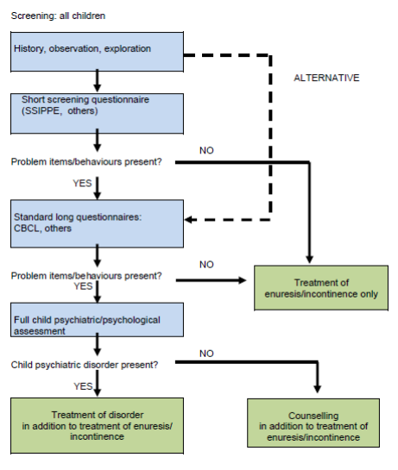
Notes:
Flow chart for assessment of psychological symptoms (subclinical) or disorders (clinical): specific treatment forenuresis/incontinence is the same for all children; those withsymptoms require counseling, those with disorders need treatment (from von
Gontard et al, 2011b)
In a child psychiatric setting, a routine assessment regarding comorbid
emotional and behavioural disorders is recommended. In all other settings
(paediatric, urologic etc.) at least a screening with a validated and standardised
parental questionnaire is recommended because of the high frequency of comorbid
disorders (von Gontard et al, 2011b). This can be done in one or two stages,
either by using a short screening questionnaire, such as the SSIPPE (Van Hoecke
et al, 2007), first and a long questionnaire next, or by using a long questionnaire
such as the CBCL (Achenbach, 1991). If many problem items are endorsed, a
full assessment by a child psychologist or psychiatrist should follow. If comorbid
disorders are present, they should be treated (see Figure C.4.1).

Slide 24
Enuresis
General Principles of Treatment
Overall: non-pharmacological interventions>medication
Treat only after age 5
Treatment should be symptom oriented
Primary psychotherapy is not effective
Treat comorbidities separately
Treat encopresis and constipation first
Treat daytime incontinence first
Treat primary and secondary enuresis in
same way
Notes:
Again, treatment of enuresis and urinary incontinence is based on simple,
effective steps that can be delivered in many primary care settings. However, it is
time-consuming as most interventions require cooperation of the child and parents.
More detailed information is provided in von Gontard and Neveus (2006).
Enuresis
Several meta-analyses have shown conclusively that, overall, nonpharmacological
interventions are more effective than medication, which also has
its place if indicated (Houts et al, 1994; Lister-Sharp et al, 1997). The classic metaanalysis
of Houts et al (1994) shows this quite clearly (Figure C.4.2).
General principles
Certain general principles should be followed for treatment:
• A child should be at least 5 years of age (the age required to diagnose enuresis
and urinary incontinence), younger children do not require treatment
• Treatment should always be symptom-orientated, aimed at achieving
continence (i.e., complete dryness). Primary psychotherapy for enuresis
is not effective and not indicated. Comorbid disorders should be treated
separately according to evidence-based recommendations
• When there are several concurrent disorders, encopresis and constipation
should be treated first because some children will stop wetting once these
problems have been dealt with
• Daytime incontinence should be treated first, as many children will stop
wetting at night once the daytime problems have been treated
• In non-monosymptomatic enuresis, all daytime bladder problems should
be tackled first (according to the principles of urinary incontinence) before
starting the specific treatment of enuresis
• Primary and secondary enuresis are treated in the same way

Slide 25
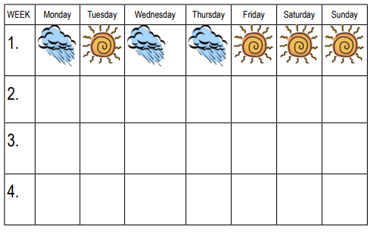
Enuresis
Initial Treatment Steps
Counseling, support, information
Enhance motivation
Alleviate guilt
Education: drinking and toileting
Discontinue all ineffective measures
  Punishment
  Fluid restrictions
  Waking and lifting
  Ineffective medication
  Alternative medicines
Record wet and dry nights for 4 weeks
Notes:
The initial treatment steps are simple, non-specific aspects of “good practice”:
• Counselling, support and provision of information
• Enhancing motivation and alleviating guilt feelings
• Educating about drinking and toileting habits: drinking more fluids during
the day, taking time while on the toilet, sitting in a relaxed way, refraining
from holding manoeuvres, etc.
• Discontinuing all ineffective measures such as punishing the child, fluid
restrictions, waking and lifting, ineffective medication, other alternative
medicine treatments
• A baseline period is then recommended with a simple observation and
recording of wet and dry nights over a period of 4 weeks. Children are
asked to draw a symbol for wet and dry nights (clouds and suns, stars, etc.)
in a chart and bring it to the next consultation. An example of chart is
depicted in Appendix C.4.4.
These simple measures will achieve dryness in 15-20% of cases without
further intervention and are supported by evidence (Cochrane review of Glazener
and Evans, 2004). If these simple interventions do not suffice, specific treatment
is required.

Slide 26
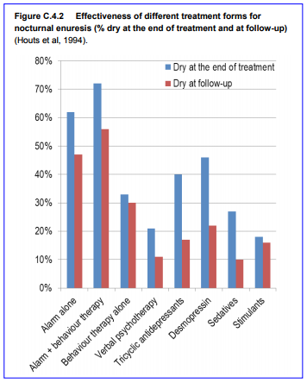
Notes:
Two main interventions are available: alarm treatment and pharmacotherapy.
As alarm treatment is more effective and has the best long-term results, this should
be the first line treatment if child and parent are motivated. As shown in Figure
C.4.2, 62% of children are dry at the end of treatment and 47% at follow-up.
Houts et al (1994) conclude that “urine alarm treatments should not only be
considered the treatment of choice, but the evidence from this review suggests
that cure rather than management is a realistic goal for the majority of childrensuffering from nocturnal enuresis.” A Cochrane review of 22 RCT’s involving 1125
children concluded: “Alarm interventions are an effective treatment for nocturnal
enuresis. Desmopressin and tricyclics appeared as effective while on treatment,
but this effect was not sustained after treatment stopped and alarms may be more
effective in the long run” (Glazener et al, 2005).
If alarm treatment cannot be implemented adequately, medication
(desmopressin) is the second line treatment. If either method fails, a switch to
the other treatment is recommended (Neveus et al, 2010) and was shown to be
effective (Kwak et al, 2010).

Slide 27
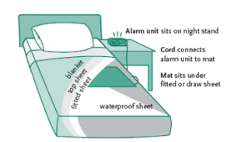
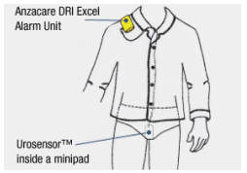
Enuresis
Alarm Treatment
Notes:
An alarm consists of a pad or a metal sensor, which is connected to a bell by
a wire. Once the sensor becomes wet, an electric circuit is closed and the alarm is
set off. Alarms are very simple devices; they can be cleaned and used by different
children many times over. Sterilisation is not required, as urine is per se a sterile
fluid (unless UTI‘s are present), cleaning with a surface disinfectant is enough.
Two different types of alarms exist, body worn and bedside. In body worn
alarms, the bell is attached to the night dress while the sensor is attached to the
underpants. If desired, body worn alarms can be used with diapers. In bedside
alarms, a metal foil or a cloth pad (with integrated wires) is placed under the top
sheet of the bed and connected to an alarm next to the bed. Both alarms are equally
effective. Therefore, children should decide which alarm they prefer.
The alarm should not just be prescribed but its functions demonstrated and
shown directly during the consultation. Children should feel responsible for their
treatment. Some instructions are extremely important and should be gone through
in detail with parents and child:
1. Children are asked to go to the toilet before going to bed
2. The alarm is attached and switched on
3. In case of a dry night, nothing happens and the child can turn off the
alarm the next morning. In case of wetting, the alarm is triggered and
the child should wake up completely, either by themselves or with
parental help
4. The child is asked to go to the toilet and urinate
5. The night dress and the bedding are changed and the alarm is reset.
6. The child should be actively involved in this process. If the child wets a
second time during the night, the whole routine is repeated.
7. Parents are asked to record all relevant data in a chart (see Appendix
C.4.5).
To be successful, the alarm must be used every night for a maximum of 16
weeks. Some children become dry in only a few weeks, most will require 8 to 10
weeks and some a little longer. After 14 consecutive dry nights, use of the alarm
is discontinued and the child is considered to be dry. Parents are advised to restart
alarm treatment if a relapse (two wet nights per week) happens, this occurs in up
to 30% of cases.
The alarm treatment relies on operant conditioning and should be
enhanced with other measures including positive reinforcement with praise and
other rewards, as well as aversive consequences such as getting up, going to the toilet and remaking the bed (Butler, 1994). Dryness can be achieved by two basic
mechanisms: either children learn to wake up and go to the toilet (one third) or
they sleep through the night without wetting (two thirds).
Usually, simple alarm treatment is sufficient. It can, however, be reinforced
by additional means. A simple addition to the alarm is the so called “arousal
training” by van Londen et al (1993). In arousal training the alarm is set up before
sleep, the alarm is triggered, children are instructed to turn off the alarm within
three minutes, go to the toilet and reset the alarm. If this is achieved correctly
children are rewarded with two tokens, such as stickers. If this is not achieved, one
token has to be returned. In younger children, we found it advisable to modify this
training: children receive one token if they are successful but do not have to pay
back a token, which would be too frustrating for them. Arousal training has been
shown to be more successful than alarm alone. A well-known training program is
“dry bed training” by Azrin et al (1974). This is a complicated, difficult to perform
program which starts with an intensive night (in which the child is awaken once
every hour until 1 am) followed by maintenance treatment. Meta-analyses have
shown that “dry bed training” is no more effective than alarm treatment alone
(Lister-Sharp et al, 1977). Therefore, it is not recommended.
The combination of alarm treatment and desmopressin cannot be
recommended due to conflicting results. However, if a child has urge symptoms
(i.e., a non-monosymptomatic enuresis) a combination of anticholinergic medication (for example 2.5mg to 5mg Oxybutinin or Propiverin at night) is
helpful, otherwise the alarm may go off several times per night and the outcome
will be less favourable.

Slide 28
Enuresis
Medication Indications
Unwillingness for alarm treatment
Lack of motivation
Overwhelmed family
Short-term dryness required quickly
2 medication choices:
  Desmopressin (preferred)
  Tricyclic antidepressants
Notes:
Indications for medication are:
• Unwillingness to undertake alarm treatment
• Lack of motivation in the children
• Family overwhelmed by demands such as a work situation, cramped
housing, infants to care for, i.e., cooperation with alarm treatment is not
possible
• Short-term dryness is required, e.g., for school outings.
There are two groups of medication with a clear antienuretic effect:
desmopressin and tricyclic antidepressants (TCAs). Although both are effective,
desmopressin has less side-effects and is therefore the preferred substance.
Tricyclic antidepressants such as imipramine have a proven anti-enuretic
effect and similar relapse rates as desmopressin. Due to cardiac arrhythmias
even with therapeutic doses, a detailed family history, ECG before and during
treatment and blood tests are recommended. A low dose of 10mg to 25mg in the
evening (1mg per kg of body weight per day or less) is often sufficient. If higher
doses are necessary, imipramine should be give 3 times a day and the medication
slowly increased to a maximum of 3mg per kg of body weight per day. Due to side
effects (and toxic effects in case overdosage), imipramine has become a third line
treatment for severe therapy-resistant cases.

Slide 29
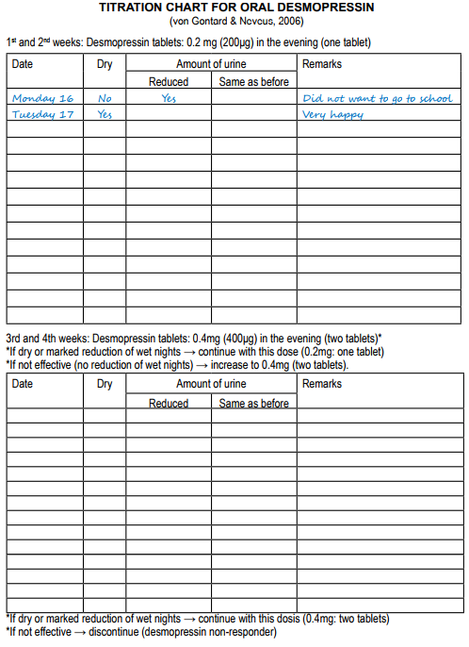
Enuresis
Medication: Desmopressin
(DDAVP)
Synthetic antidiuretic hormone
Effective in 70% of cases
Relapse common after discontinuation
Tablet form in evening
0.2mg-0.4mg titrated over 4 weeks
Stop after 12 weeks; may repeat
Monitor for hyponatremia
Otherwise well tolerated
Notes:
Desmopressin (1-deamino-8-D-arginine vasopressin, abbreviated DDAVP)
is a synthetic analogue of the antidiuretic hormone (ADH). A reduction of wet
nights or even dryness can be achieved in 70% of cases: 30% of children are full
responders, 40% partial responders, and 30% non-responders (Neveus et al, 2010).
After discontinuing medication most children relapse, so that desmopressin has a
low curative potential (Neveus et al, 2010). According to van Kerrebroeck (2002),
only 18%-38% of children remain dry 6 months after medication is withdrawn.
Compared with the alarm, desmopressin has a distinctly lower curative effect in
the long run.
Desmopressin is taken in tablet form in the evenings only. The oral dosage
is 0.2mg to 0.4mg. It is advisable to titrate the required dosis over 4 weeks, as
shown in the chart in Appendix C.4.6. One starts with the low dosage of 0.2mg in
the evening for two weeks. If the child is dry or a marked reduction of wet nights
is documented one stays with this dosage. Otherwise, medication is increased to 0.4mg in the evening. If children do not become dry with 0.4mg, they are
considered to be non-responders and desmopressin is discontinued. Otherwise,
one can continue with the required dosage for a maximum of 12 weeks, after which
desmopressin should be stopped to check if the child can remain dry without
medication. If a relapse occurs, desmopressin can be given for another 12 weeks
and this regime can be continued for as long as indicated. Adverse effects are rare
and not pronounced, like head and stomach aches, lack of appetite, etc. The most
dramatic, though rare side effect is hyponatremia and water intoxication, which
may require intensive care. Therefore it is important not to overdose and not to
drink a large amount of fluids after taking the medication. Laboratory blood tests
are not necessary.

Slide 30
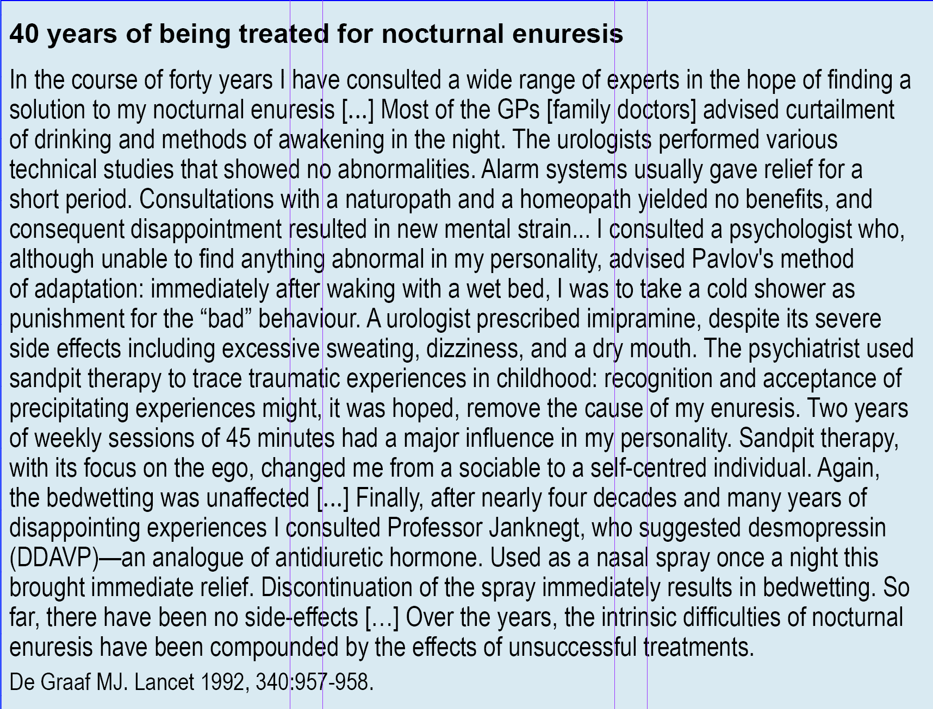

Slide 31
Enuresis
Treatment: Urinary Incontinence
Urge→ toilet (no holding)
Wet/dry chart
Go to toilet in any situation
Works in 1/3
Other 2/3: oxybutine
  0.3-0.6 mg/kg per day in 3 doses
  Max daily: 15 mg
  Dose dependent, reversible side effects
  Flushing, blurred vision, tachycardia, hyperactivity, dry mouth, residual urine, constipation
Notes:
The same basic principles as in the treatment of enuresis should be followed,
e.g., provision of information, counselling, supporting and motivating both child
and parent is essential.
The main focus in the treatment of urge incontinence is a symptom-oriented
cognitive-behavioural approach aimed at a conscious control of the urge without
the use of the pelvic floor muscles, i.e., holding manoeuvres (Vijverberg et al,
1997). Children are instructed to note when they feel an urge and go to the toilet
right away without using holding manoeuvres. They are asked to document in a
chart if their pants were dry (with the symbol of a flag, for example) or if they were
wet (with the symbol of a cloud, for example). This means, that children should be
allowed to go to the toilet in any situation, especially in kindergarten and school.
If adhered to, the number of voidings is typically reduced first, followed by a
reduction in the number of wet episodes.
This simple approach is sufficient for 1/3 of children; the other 2/3 will
require additional medication. Monitoring – observing and documenting (i.e.,
the cognitive-behavioural component) – should continue throughout the therapy.
Anticholinergic medication is indicated. Oxybutine is a well-known preparation
available as generic drug in most countries. It should be introduced slowly to
avoid side-effects up to an initial dosage of 0.3mg per kg of body weight per day
in 3 doses (maximum daily dosage: 15mg). If not effective, it can be increased
to 0.6mg per kg of body weight per day (maximum 15mg/day). Side-effects are
dose-dependent and reversible. They include typical anticholinergic effects such as
flushing, blurred vision, tachycardia, hyperactivity, dryness of the mouth, residual
urine and constipation.
An alternative is propiverin, which unfortunately is not available in many
countries. The dosage is a maximum of 0.8mg of body weight per day in two
doses (with a total maximum of 15mg/day). Side effects are similar but possibly
at a lower rate. If one of these two standard medications is not effective or is
accompanied by too many side effects, a switch-over to the other medication is
recommended. Other anticholinergic medications such as tolterodine, solifenacine
and others are used in adults but are not recommended for standard treatment in
children.
A symptom-oriented approach is indicated in all cases of voiding postponement.
The first step is provision of information and psycho-education. Often, the
association of voiding postponement, retention of urine and incontinence are not
known to parents and children. Children and parents are instructed to increase the
frequency of micturition. The goal is to go to the toilet seven times a day at regular
intervals. Children should sit on the toilet in a relaxed way and take plenty of time.
Micturitions in the toilet as well as wetting episodes are noted in a chart. Often this
requires parents to send their child to the toilet. To increase motivation, a simple
token system with positive reinforcements can be added. In older children, digital
wrist alarm watches (or cell phones) can be of help. Intervals of 1½ to 3 hours are
set to remind the child to go to the toilet. However, these approaches are often
not sufficient because of the high behavioural comorbidity, especially with ODD,
which requires additional treatment.
Treatment of dysfunctional voiding includes increasing motivation, cognitivebehavioural
elements, relaxation and general drinking and toileting advice (Chase
et al, 2010). If necessary, voiding frequency and oral fluids can be increased. Toilet
re-training is initiated. It is recommended that children take a lot of time, sit in
a relaxed manner on the toilet seat, spread their legs apart and have contact with
the floor either directly or with a little foot stool. The children are asked to relax
completely, initiate micturition without straining and simply let the urine flow
until they have the feeling that the bladder is empty. The most specific and effective
treatment is biofeedback – either with uroflowmetry or pelvic-floor EMG (Chase
et al, 2010). Signals of the urine stream or pelvic floor contractions are presented
to the child in real time either visually or acoustically. Many child-friendly
programmes and animations are available. EMG-feedback can be performed at
home under instruction; otherwise, biofeedback is limited to specialised outpatient
departments and beyond the scope of most primary care services. Coordination
and continence can be achieved in a few sessions in most children. Medication is
not indicated (Chase et al, 2010).
Giggle incontinence is treated with a classical conditioning paradigm
(Elzinga-Plomp et al, 1995) or with high-dose methylphenidate (due to the overlap
with cataplexy and narcolepsy) (Sher & Reinberg, 1996). Stress incontinence
is treated by physiotherapy or imipramine. Children with underactive bladder
require an intensive training and often intermittent catheterisation. All of these
rare disorders do require specialised treatment (see von Gontard & Neveus, 2006).
In therapy-resistant cases, structured group therapies have been successful
(Equit et al, 2012). These combine counselling, provision of information, relaxation
techniques, cognitive-behavioural, play and group therapy approaches.

Slide 32
Enuresis
Course
Excellent long-term outcome
13% spontaneous remission rate per year
60-80% become dry with alarm treatment; 50% dry long-term
1-2% adolescents have long-term enuresis
Adult prevalence <2%
Urge incontinence has best prognosis
Notes:
Enuresis has excellent long-term outcome with a high spontaneous
remission rate – 13% per year – and effective treatments are available; 60% to 80%
become dry with alarm treatment and 50% remain so on the long-term (Houts
et al, 1994). Still, a small group of children have chronic enuresis with 1%-2% of
adolescents affected. Nocturia (waking up at night and voiding) can be a residual
symptom. The prevalence of enuresis overall is 1.7% in adults, with an 8-fold risk
for enuresis if they had wetted as children (Hublin et al, 1998).
Studies of the long-term outcome of daytime incontinence are lacking.
Urge incontinence seems to have the best prognosis, while voiding postponement,
especially combined with ODD is difficult to treat. Daytime incontinence increases
in adulthood with age, especially in women, although these are not necessarily a
consequence of childhood incontinence.

Slide 33


Enuresis
Further Resources
http://i-c-c-s.org/
https://www.nice.org.uk/guidance/cg111

Slide 34

Enuresis
Thank You!

