Slide 1

EXTERNALIZING DISORDERS
Chapter D.1
Attention Deficit Hyperactivity Disorder
Tais S Moriyama,
Aline C M Cho, Rachel E Verin, Joaquín Fuentes &
Guilherme Polanczyk
Companion PowerPoint Presentation
Adapted by Henrikje Klasen & Julie Chilton

Slide 2
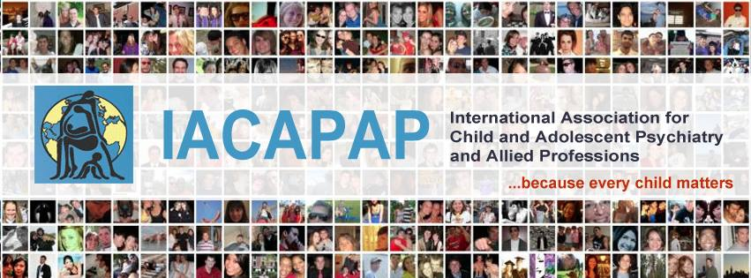
The “IACAPAP Textbook of Child and Adolescent Mental Health” is available at the IACAPAP website http://iacapap.org/iacapap-textbook-of-child-and-adolescent-mental-health
Please note that this book and its companion powerpoint are:
· Free and no registration is required to read or download it
· This is an open-access publication under the Creative Commons Attribution Non- commercial License. According to this, use, distribution and reproduction in any medium are allowed without prior permission provided the original work is properly cited and the use is non-commercial.

Slide 3

ADHD
Learning Objectives
Differentiate and diagnose
  Mild or marked ADHD
  Other related mental/physical health problems
Treat or manage through:
  Psycho-education
  Basic psycho-social interventions
  Pharmacotherapy
Know when to refer patient to a specialist
Notes:
At the end of this session you should be able to:
define, recognize, diagnose and manage ADHD

Slide 4

ADHD
General Considerations
Inattention, hyperactivity and
impulsivity
Two Diagnoses:
  ADHD (DSM)
  Hyperkinetic Disorder (ICD)
Affects 3-5% of children
Abnormal neuro-psychological
functioning and neurobiological
correlates
Tree climbing (Vauvau, 2009)
Notes:
Inattention, hyperactivity and impulsivity are common in the general population and may represent transitory or normative developmental patterns, but if this leads to impairment, these children may suffer from ADHD (DSM) or Hyperkinetic Disorder (ICD)
ADHD and Hyperkinetic Disorder affect children throughout the world at a rate of about 3-5%
As a group these children have well-known risk factors and show abnormal neuro-psychological functioning and neurobiological correlates
We will mostly use the term ADHD

Slide 5

ADHD
Historical Note
1800’s Heinrich Hoffman
  “Impulsive Insanity”
  &
  “Defective Inhibition”
Der Struwwelpeter, an illustrated book portraying children misbehaving (“Impulsive Insanity/Defective Inhibition”) by Heinrich Hoffman (1854).
Notes:
Der Struwwelpeter, an illustrated book portraying children misbehaving (“Impulsive Insanity/Defective Inhibition”) by Heinrich Hoffman (1854).
ADHD has long been described in the medical literature. Heinrich Hoffmann (1809-1894), a German psychiatrist, was the first to describe children whose behavior was marked by impulsivity and hyperactivity. He named this behavioral problem “impulsive insanity” or “defective inhibition”.

Slide 6
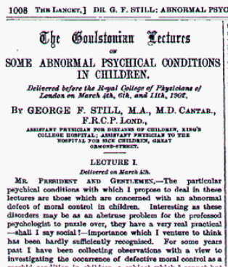
ADHD
Historical Note
1902 Lancet article
1920’s “minimal brain damage”
1930’s “hyperkinetische Erkrankung”
1960’s “minimal brain dysfunction”
1937 Benzedrine discovered
Hyperkinetic Syndrome of Childhood” in ICD-9
1980 inattention recognized
DSM-III Attention-Deficit Disorder with or without Hyperactivity
Notes:
In 1902 the pediatrician George Still published in The Lancet a description of children with motor agitation, attention problems, difficulty in controlling impulses and need for immediate reward (Still, 1902; Figure D.1.1). In his description he attributed the behavioral characteristics to the fact that these children had “no consideration for others” and called the disorder “deficit of moral control”. This historical misconception is emblematic of the stigma associated with ADHD symptoms: affected children are commonly misinterpreted as having control over their behavior and being responsible for their symptoms. In the following decades the syndrome was associated with brain lesions and the disorder was named minimal brain damage (Hohman, 1922, Kahn & Cohen, 1934). This label brought to the disorder the status of a biological rather than a moral problem but carried the incorrect assumption that ADHD was the result of a brain injury. Later it was recognized that not all children had physical observable lesions and thus it was renamed minimal brain dysfunction (Clements & Peters, 1962). In 1934 Kramer-Pollnow described a syndrome he referred to as hyperkinetische Erkrankung (hyperkinetic disease) characterized by restlessness and distractibility (Sharkey & Fritzgerald, 2007). In 1937 the first effective treatment for ADHD was described by Bradley who reported that benzedrine could decrease hyperactivity and improve attention and academic performance (Bradley, 1937).

Slide 7

ADHD
In Your World
Relevance in your country?
Tell us about your cases
Do local people recognize ADHD?
Is ADHD more of a problem in high income countries (HIC)?
Are there any other points to discuss?
Notes:
What is the relevance of ADHD in children and adolescents in your country?
In your personal experience ?
Tell us about cases you have encountered
Do local people recognize ADHD as a (medical) problem?
What do they call these problems?
How do they treat them?
Do you think ADHD is more of a problem in high income countries (HIC)?
Are there any other points you want to discuss?

Slide 8
ADHD
Impact of ADHD in LAMIC vs. HIC
Ahmed and Peter are both 7 years old and both have ADHD, combined type… listen to their story
Ahmed lives in a small village in Africa. He goes to school in the mornings and plays or herds his father’s goats afterwards.
Peter lives in a medium size town in Western Europe. He goes to school until 3 pm then usually plays football with his friends.
How does ADHD impact their lives?
Notes:
Ahmed and Peter are both 7 years old and both have ADHD, combined type. Neither of them can sit still or concentrate for long and both are easily distracted. They love to run around, they are impulsive and often make careless mistakes or forget things because they act before they think. They are both bright boys, talk a lot but cannot wait for their turn and constantly interrupt others.

Slide 9
ADHD
Impact of ADHD: Education
Listen to Ahmed and Peter’s experience at school...
What will happen to Peter and Ahmed’s education after they have been expelled from
2nd year primary school?
Notes:
Ahmed and Peter both started school last year. They both love learning and really did their best for the first few weeks. However, after a while they started to become very disruptive. They cannot sit still and get up in the middle of the lesson. They blurt out answers before their turn. They are noisy and interrupt others. They are inattentive and make careless faults. Teachers have tried everything from punishment to patience, but now in grade 2 they feel the boys are just interrupting the learning of others so much that they have to be expelled

Slide 10
ADHD
Impact of ADHD: Impulsivity/Distractibility
Listen what happens when Ahmed and Peter get impulsive…
Children with ADHD are accident prone.
How will the broken leg impact on the lives of Peter and Ahmed? How long will it take to get help? What if an operation is needed?
Notes:
When Peter comes from football training he sees a nice tree and climbs on top. He fails to notice the branch he climbs on is rotten. He falls and breaks his leg in a nasty way. He is with friends in a small park in town about 1 km from his house.
When Ahmed is out in the country with the goats he sees a nice tree and climbs on top. He fails to notice the branch he climbs on is rotten. He falls and breaks his leg in a nasty way. He is with friends and the goats about 1 km from the village.

Slide 11
ADHD
Impact of ADHD: Inattention/Forgetfulness
Listen what happens, if Ahmed and Peter fail to pay attention and become forgetful…
Children with ADHD are forgetful.
How does the loss of something expensive impact on the lives of Peter and Ahmed? Will they be punished? How? Will it affect the family as a whole?
Notes:
When Peter leaves football training he sees an interesting bird. He puts his football bag down as he tries to get closer. Eventually the bird flies off and Peter moves on. He forgets the bag. He walks back later, but the bag with the expensive football shoes is gone.
When Ahmed is out in the country with the goats he sees an interesting bird. He just had a small goat on his arm that got separated from the herd. He puts it down as he tries to get closer to the bird. Eventually the bird flies off and Peter moves on. He forgets the baby goat. He walks back later, but the baby goat is gone.

Slide 12
ADHD
Why Do You Need to Know?
ADHD:
Is common
Can be serious
Can persist
Is stigmatizing
Is treatable
Notes:
ADHD is common in all cultures
ADHD can be serious: untreated it can lead to educational failure, accidents and unfair harsh punishments that may worsen the behaviour and outcome.
Severe ADHD can persist into adulthood with risk of : marriage breakdowns, unemployment, accidents, other psychiatric disorders
ADHD is stigmatizing: Patients or their families may be blamed for the bahaviours, suffering social exclusion
ADHD is treatable with several evidence
based treatments

Slide 13

ADHD
The Basics
Core symptoms
  Inattention, hyperactivity, impulsivity
  Present in more than one context
  Leading to functional impairment
Subtypes
  In DSM: combined, predominantly
  hyperactive, predominantly inattentive
  In ICD: Hyperkinetic disorder
https://www.youtube.com/watch?v=GR1IZJXc6d8&feature=related
Notes:
Core symptoms
Inattention, hyperactivity, impulsivity
Present in more than one context
Leading to functional impairment
Subtypes
In DSM: combined, predominantly hyperactive, predominantly inattentive (sometimes called ADD)
In ICD: Hyperkinetic disorder – similar to ADHD combined type
Click on the link to hear Russell Barkley PhD describe his understanding of executive functions ad their relevance for ADHD

Slide 14
ADHD
Epidemiology
Prevalence
  6% for children
  3% for adolescents
Male>Female
ADHD (DSM definition) > HKS (ICD definition)
Notes:
Prevalence estimates of ADHD vary depending on the criteria used. A recent systematic review pooled data from 102 studies from all over the world and computed a rate of 5% for individuals bellow 18 years of age, 6% for school age children and 3% among adolescents (Polanczyk et al, 2007). Although estimates were heterogeneous, there was no clear evidence of variation across cultures. Pooled data confirmed a higher prevalence among males than females, a widely acknowledged clinical observation.
ADHD (DSM definition) > HKS (ICD definition)

Slide 15

ADHD
Differences According to Age
Pre-school: play < 3mins, not listening, no sense of danger
Primary school: activities < 10 mins, forgetful, distracted, restless, intrusive, disruptive
Adolescence: attention< 30 mins, no focus/planning, fidgety, reckless
Adult: incomplete details, restless, forgetful, impatient, accidents
Notes:
See Table D.1.1
Pre-school:
play < 3minutes, not listening “whirlwind”, no sense of danger
Primary school:
activities < 10minutes, forgetful, distracted, restless, intrusive, disruptive
Adolescence:
less persistent than others > 30 minutes, lack of focus/planning, fidgety, reckless
Adult:
details not completed, feels restless, appointments forgotten, impatient, accidents.

Slide 16
ADHD
Course
Some chronic
Unclear persistence (Faraone 2006)
  15% full persistence
  40-60% partial remission
Severe cases more persistent
Notes:
Growing evidence indicates that ADHD is a chronic disorder and that symptoms often persist into adult life, although disagreement exists about the extent of this; estimates vary across studies − most of the variation may be due to methodological differences such as definition of persistency (presence of symptoms or the full syndrome) and age when individuals are evaluated (Mannuzza et al, 2003). A recent review found a persistency of 15% for young-adults when presence of the full syndrome is considered, and 40-60% when cases in partial remission are included (Faraone et al, 2006).
Persistence of symptoms seems to be associated with severity.

Slide 17
ADHD
Associations with Durability of Symptoms
Lower academic achievement
Marital problems and dissatisfaction
Divorce
Difficulties dealing with offspring
Lower job performance
Unemployment
Employment below potential
Traffic accidents
Other psychiatric disorders
Notes:
Durability of symptoms is also associated with negative outcomes such as lower academic achievement (Mannuzza et al, 1997), marital problems and marriage dissatisfaction, divorce, difficulty dealing with offspring (Barkley & Fischer, 2010), lower job performance, unemployment, maintaining job positions below the individual’s potential (Stein, 2008; Mannuzza et al, 1997), involvement in traffic accidents (Barkley & Cox, 2007) and increased risk for other psychiatric disorders (Mannuzza et al, 1998).

Slide 18
ADHD
Etiology & Risk Factors
Strong genetic component (76%)
Perinatal factors – some evidence
Neurobiological deficits – growing evidence
Deprivation and family factors – important for course and outcome
Discuss:
  popular explanations in your cultural context?
Notes:
Genetics: proportion of variance attributed to additive genetic factors 76%
Negative results in genome wide association studies and most associated candidate genes only responsible for small increase in risk.
Most genes implied related to catecholaminergic system (DAT 1 – dopamine transporter gene)
Most probable gene environment interactions, or gene-gene interactions
Perinatal Factors: most evidence for association with prematurity, low birth weight and Intra-uterine tobacco exposure
Neurobiological deficits (slight differences in mean values not brain damage)
Fronto-striatal dysfunction (executive function and inhibitory control)
Catecholaminic dysregulation
Delay in cortical maturation
Deprivation and family factors: implied by epidemiological studies: more common in low SES, institutions etc. but may also be related to course and outcome rather than causation
Popular explanations that students may be confronted with by parents (e.g. through newspaper and internet articles) should be explored and discussed: i.g. food allergies (some evidence for some cases) computer games (no evidence) environmental toxins (inconclusive) but also any other culturally relevant explanatory models

Slide 19
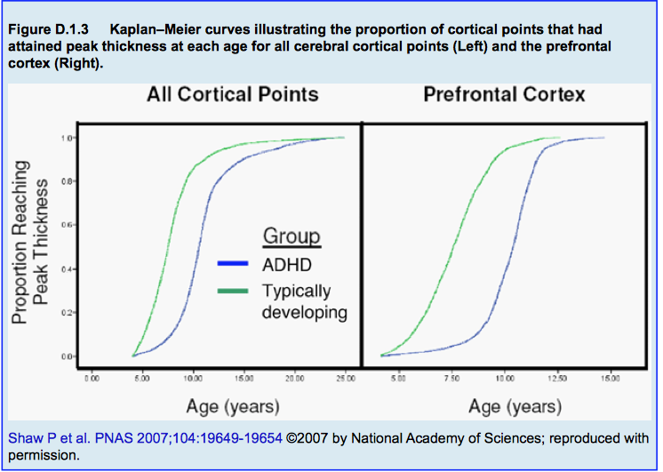
ADHD
Neurobiology
Frontal-striatal dysfunction
  mediated by GABA
  modulated by catecholamines
Catecholaminergic dysregulation
Delay in cortical maturation
Notes:
Genetics: proportion of variance attributed to additive genetic factors 76%
Negative results in genome wide association studies and most associated candidate genes only responsible for small increase in risk.
Most genes implied related to catecholaminergic system (DAT 1 – dopamine transporter gene)
Most probable gene environment interactions, or gene-gene interactions
Perinatal Factors: most evidence for association with prematurity, low birth weight and Intra-uterine tobacco exposure
Neurobiological deficits (slight differences in mean values not brain damage)
Fronto-striatal dysfunction (executive function and inhibitory control)
Catecholaminic dysregulation
Delay in cortical maturation
Deprivation and family factors: implied by epidemiological studies: more common in low SES, institutions etc. but may also be related to course and outcome rather than causation
Popular explanations that students may be confronted with by parents (e.g. through newspaper and internet articles) should be explored and discussed: i.g. food allergies (some evidence for some cases) computer games (no evidence) environmental toxins (inconclusive) but also any other culturally relevant explanatory models

Slide 20
ADHD
Associated Features
Defiant, aggressive antisocial behaviors
Problems with social relationships
IQ tends to be lower than in the general population
Specific learning problems
Co-ordination problems
Specific developmental delay
Poor emotional self-regulation

Slide 21
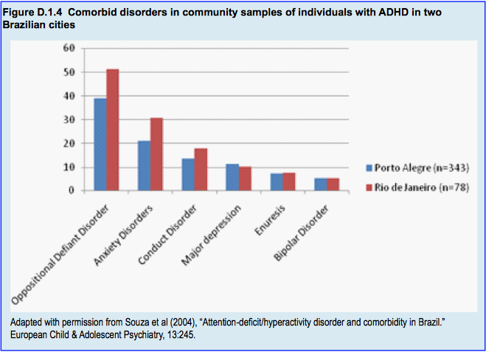
ADHD
Comorbid Disorders in Brazilian
Community Samples
Notes:
Children with ADHD often suffer from other psychiatric conditions; systematic screening for the presence of other mental disorders is essential. Figure D.1.4 shows the prevalence of comorbid disorders in two Brazilian cohorts of children with ADHD; oppositional defiant disorder, anxiety disorders, conduct disorders and depression are among the most frequent (Souza et al, 2004).

Slide 22
ADHD
Clinical Presentation/Diagnosis
Inattention
Hyperactivity
Impulsivity
Pervasive symptoms
Duration/age of onset
Impairment or distress
*Diagnosis exclusively made on clinical grounds
Notes:
Inattention:
Distractibility, forgetfulness, inability to finish what they start etc.
Hyperactivity:
On the go all the time, restlessness, fidgeting, talking too much, inability to play quietly etc.
Impulsivity:
Difficulty in delaying gratification, taking turns in play, acting without thinking
Symptoms need to be pervasive (need for multiple
informants! School!)
Duration/Age of onset
Impairment or distress

Slide 23
ADHD
Clinical Assessment
Information from at least two contexts
  Teachers are key
Medical and psychiatric assessment
Assess co-morbidity
No additional tests necessary
Notes:
Always obtain information from at least two contexts (e.g., home, school)
Perform medical and psychiatric assessment
History, family functioning, parenting style etc.
Patient might be well behaved during the clinical interview
Assess medical and psychiatric DD/co-morbidity
No additional tests necessary for diagnosis.

Slide 24
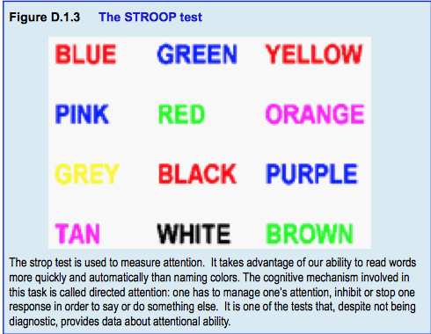
ADHD
Neuropsychological Testing
Notes:
Only for research use
The majority of neuropsychological tests are copyrighted and expensive, which restricts their use, although specific tests can be of help. Intelligence tests (e.g., Wechsler) can be useful in clarifying intellectual deficits or IQ level and its implications. The Continuous Performance Test (CPT-II), Wisconsin Cart- Sorting test, STROOP test, and “Go/no go” tests are useful for research.
The stroop test is used to measure attention. It takes advantage of our ability to read words more quickly and automatically than naming colors. The cognitive mechanism involved in this task is called directed attention: one has to manage one’s attention, inhibit or stop one response in order to say or do something else. It is one of the tests that, despite not being diagnostic, provides data about attentional ability.

Slide 25
ADHD
Differential Diagnosis
Situational hyperactivity
Behavioral disorders (ODD/CD)
Emotional disorders
Tics, chorea or other dyskinesias
Misuse of substances
Autism Spectrum Disorder
Intellectual Disability
*Frequent Comorbidity*
Notes:
As already mentioned, the diagnosis of ADHD is clinically-based and no additional tests are necessary unless the clinician suspects the presence of other conditions (American Academy of Pediatrics, 2011).

Slide 26
ADHD
Further Differential Considerations
Parental mental health issues
Severe marital discord or recent divorce
Domestic violence
Child abuse or neglect
Severe bullying or exclusion by peers
Severe deprivation or poverty

Slide 27
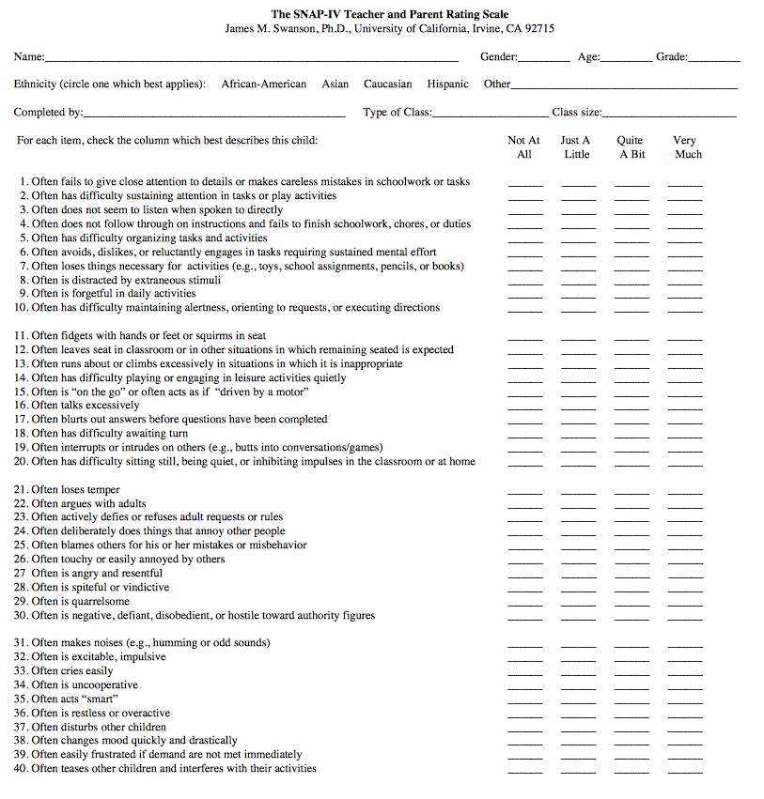
ADHD
Rating Scales
SNAP IV: http://www.adhd.net/snap-iv-form.pdf
SDQ : http://www.sdqinfo.org
SWAN: http://www.adhd.net/SWAN_SCALE.pdf
Many other proprietary (not free) scales
Notes:
Not necessary for diagnosis but very useful for monitoring symptoms during treatment
While diagnosis cannot be made on the basis of rating scale data alone, using rating scales is good clinical practice for screening purposes, to measure symptom severity and to monitor response to treatment and outcome. There are numerous rating scales that can be either specific for ADHD or for general psychopathology, most have a child, parent and teacher versions. Some of the rating scales available in the public domain include:
SNAP IV:
(5–11 years) Swanson et al (2001)
• Self
• Parent
• Teacher
There are several versions:
90-item (full version); rates several dimensions of behavior apart from ADHD and includes SKAMP (to measure severity of impairment at school); it takes about 30 minutes to administer
31-item version (includes rating of ADHD and oppositional defiant disorder); it takes 10 minutes to administer
SWAN:
(5–11 years) Swanson et al (2001)
• Self
• Parent
• Teacher
• 26 items
SDQ:
Strengths and Difficulties Questionnaire (Goodman et al, 2000)
• Self
• Parent • Teacher
Measures overall psychopathology, but a subscale can be used to screen ADHD risk
Reasonably sensible when screening “possible” ADHD illness
Available in several languages

Slide 28
ADHD
Review of Assessment Algorithm
Does the child have problems with inattention and over-activity?
Are symptoms persistent, severe and causing impairment in the child’s functioning?
Explore the impact of environmental stressors (e.g., family)
Rule out medical or other conditions
Consider ADHD if the answer to both is ‘yes’
Explore ways to address environmental stressor
as part of management
plan
Manage or refer

Slide 29
ADHD
Aims of Treatment
Individually tailored
Reduce symptoms
Improve educational outcomes
Reduce family and school-based problems
Notes:
Many targets for intervention can be enumerated: ADHD symptoms, cognitive deficits and associated behaviors, academic performance, comorbid conditions, parental psychopathology, family and school-based problems. Following assessment, clinicians should decide about targets for intervention and formulate a treatment plan integrating the different modalities needed to achieve all the treatment goals. Treatment plans should be individually tailored to each patient and constantly reviewed and updated according to emerging needs and previous response. A close monitoring of treatment response is required and should include data from different sources, including parents’, patients’ and teachers’ reports of perceived changes following interventions (Pliszka, 2007).

Slide 30
ADHD
What works?
Evidence Based Treatments:
Best evidence for stimulant medication
Behaviour treatments also effective in mild to moderate cases
Psycho-education for parents and school
Notes:
The literature is consistent on the effectiveness of stimulant medications and behavioral interventions in the management of the core symptoms of ADHD (American Academy of Pediatrics, 2011). Pharmacotherapy is effective for most children. Behavioral interventions are also valuable as primary treatment or as an adjunct treatment for many children, depending on the nature of coexisting conditions, outcomes targeted and family circumstances (American Academy of Pediatrics, 2011). Treatment plans should include at least one of these two treatment modalities (see Table D.1.5).
The decision to use non-pharmacological versus pharmacological intervention should be based on patient’s age, profile of symptoms and disease severity, individual risk for side effects, treatment adherence issues, comorbid disorders, parents’ and child’s preference, cost, access to medication, and availability of trained therapists.

Slide 31
ADHD
Psychosocial Treatments
Behavior therapy
  Individual, not always generalize
  Parent management training: particularly useful in younger children and for associated behavior problems
  School based: child in front of class, short tasks etc.
Generally effective, but smaller effect size than medication
First line treatment in younger children or milder
cases
Notes:
The effect size of behavioral interventions on ADHD symptoms is smaller than that of stimulant medications (Fabiano et al, 2009). Many guidelines for behavior therapy in ADHD are available (Bauermeister et al, 2006). In general terms, the therapist identifies problem behaviors and collects detailed data on the circumstances that precede and follow such behaviors. Usually behaviors become ingrained when reinforced. After the identification of reinforcing consequences a detailed plan on how to deal with problematic situations is drawn up and a different set of techniques to stop reinforcing unwanted behaviors or extinguish them is implemented (Antshel & Barkley, 2008). Behavior therapy for ADHD almost always involves parents and teachers as well as the child.
Parent training
Parents can be trained
to constructively deal
with their child behavior
by teaching them how
to reinforce desirable behaviors and extinguish misbehavior. For
example, how to set and communicate sensible, appropriate and achievable rules and what to do when the child adheres to the rules or breaks them. The strength of evidence for parent behavior training as the first-line intervention for improved behavior among preschoolers at risk for ADHD is high, while the strength of evidence for methylphenidate is low (Charach et al, 2011).
Individual: e.g. computerised or individualised. programmes to train concentration/attention: not always generalize
Parent management training: parents train child to concentrate, regulate emotions, complete tasks etc. and are trained to be positive and encouraging rather than critical
School based: child in front of class, short tasks etc.

Slide 32
ADHD
Stimulant Medication
Methylphenidate or Amphetamines
  Efficacy and safety well established
  ES 0.8-1.1; clinical response in 70%
  Dose: titrate for optimum response
  Short/long acting (sustained release) available
  NOT on WHO list of essential medicines
Common side effects: nausea, weight loss, insomnia, agitation
More serious side effects: tics, psychotic symptoms,
raised blood pressure, growth retardation
Notes:
Stimulant medications (see Table D.1.3) have been used for decades in the treatment of ADHD and are licensed for this purpose in many countries. The efficacy and safety of these drugs have been extensively examined in numerous clinical trials as well as in systematic reviews and meta-analyses (Swanson et al, 2007; Biederman & Spencer, 2008; Adler, 2007; Adler, 2008; Faraone & Buitelaar, 2010; Faraone & Glatt, 2010). Trials consistently show that stimulants are more effective than placebo, with effect-sizes varying from 0.8 to 1.1 and a positive early clinical response in approximately 70% of cases. Most commonly used stimulant medications include methylphenidate, dexmethilphenidate, dextroamphetamine and mixed amphetamine salts. Other agents such as methamphetamine are available in certain countries. Medications are available in different presentations, including short-acting, long-acting and sustained-release. The main advantage of long-acting and sustained-release preparations is that one dose in the morning may sustain effect during the whole day, increasing adherence. However, they are more expensive, which limits their use. No conclusive evidence exists favoring any of the stimulants over others in terms of efficacy and side effect profile.
Stimulant dosage is not weight dependent. Clinicians should begin with a low dose and titrate upward to achieve optimal response (see Table D.1.3). The best dose is the one that leads to maximum benefit with minimal side effects. Although controlled studies that compare different dosing schedules are lacking, some clinicians believe that interrupting medication during weekends and holidays may compromise its efficacy.
See Table D.1.4 for further information about monitoring or managing side effects

Slide 33
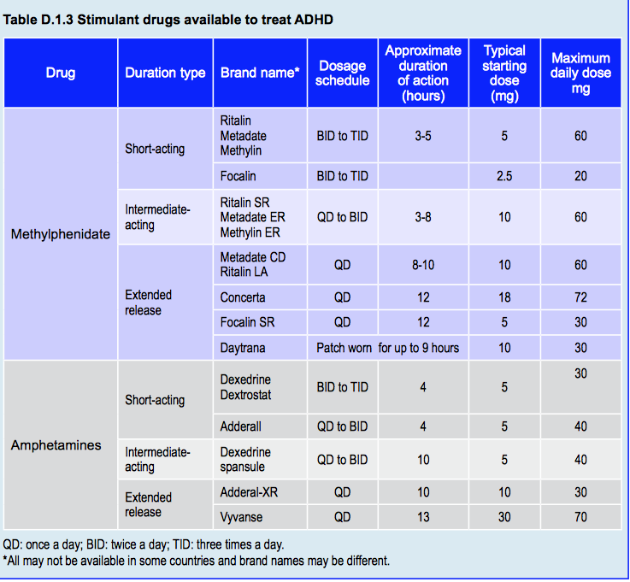
ADHD
Stimulant Medication
Notes:
Excellent table in the textbook chapter to assist with prescribing stimulants
Methylphenidate is available in immediate release and sustained release preparations. Immediate release methylphenidate reaches plasma peak levels in 1 to 3 hours after ingestion. Effects last approximately 4 hours; thus a two- or three-times-a-day schedule is necessary for symptom coverage. Methylphenidate SODAS® is a long-acting formulation in which half the amount is immediately released and the other half is released after 4 hours. Methylphenidate OROS® releases about one quarter of the amount immediately and the rest during the next 9 hours. The two later preparations only require a once-a-day dosage schedule.
There are different amphetamine preparations for ADHD but availability varies between countries. Brand names, dosing and duration of behavioral effect for each of this drugs can be found in Table D.1.3. Lisdexamphetamine has been recently approved for the treatment of children and adults with ADHD in the US, Canada and Brazil. Lisdexamphetamine is an inactive component (prodrug) that is gradually converted into an active form of dextro-amphetamine in the body. Due to its gradual conversion, effect of Lisdexamphetamine is prolonged − up to 13 hours − thus not needing repeated doses during the day. Another common form of amphetamine approved in some countries for the treatment of ADHD is a preparation of mixed amphetamine salts. It is intermediate-acting and can be taken once or twice a day (see Table D.1.3).

Slide 34
ADHD
Non-Stimulant Medication
Atomoxetine
Clonidine
  Start dose 0.1mg at bedtime
  Add a.m. dose after 3-7 days, then midday dose after 3-7 days
  Increments by 0.05-0.1mg, max. 0.4mg
Imipramine
  2-3 times/day; 1-4mg/kg/day
  30-50% response rate in 10 studies
  ECG recommended prior to treatment (cardiotoxicity)
*Non-stimulants: less effective, more side effects, try only
when stimulants not available, not tolerated or not appropriate*
Notes:
Non-stimulant medications are considered second line treatments in case of intolerance, contra-indications or treatment failure. Evidence of effectiveness of these drugs, although not as strong as for stimulants, is good for atomoxetine, extended-release guanfacine, and extended-release clonidine (in that order) (American Academy of Pediatrics, 2011):
• Atomoxetine is a selective noradrenaline reuptake inhibitor (SNRI) that appears to cause a secondary increase in dopamine levels. The estimated effect size of atomoxetine for the treatment of ADHD (approximately 0.8) is higher than that of other non-stimulant drugs but smaller than for stimulants (Hazell et al, 2011). Atomoxetine can reduce anxiety symptoms in adults and children and is an option for the treatment of ADHD with comorbid anxiety disorders. It is also preferable for patients with a history of substance misuse (or if there are other household members who use drugs because of the risk of diversion). Compared to stimulants, atomoxetine has a slower onset of action but can be taken once daily. Starting dose is 0.5mg/kg/day that can be increased up to 1.2mg/kg/day. The most frequent adverse events are transitory gastrointestinal symptoms, reduced appetite, sleep problems, increased heart rate and blood pressure. Severe but very rare side effects include hepatotoxicity, with increase in hepatic enzymes, bilirubin and jaundice; emergent suicidal behaviors (both suicidal ideation and attempts) have also been reported.
Clonidine and guanfacine are alpha-2 agonists with demonstrated efficacy in the treatment of ADHD. Guanfacine is more selective than clonidine causing fewer adverse effects such as somnolence. These medications can also be used for patients with comorbid tic disorders or Tourette’s syndrome, in which its efficacy seems to be higher. There are now long-acting formulations for both clonidine and guanfacine available.
Modafinil is a non-stimulant medication used for the treatment of narcolepsy that has been tested for ADHD; its efficacy has been demonstrated in randomized clinical trials.
Tricyclic antidepressants such as imipramine, have also been shown to reduce ADHD symptoms. Nevertheless tricyclic antidepressants are associated with significant side effects, are less effective than stimulant medications and should be used only after failure to respond to two or three stimulants and atomoxetine (AAP, 2011). Tricyclic antidepressants can interfere with cardiac conduction and can cause sudden death; it is important that patients are monitored with electrocardiogram before and during treatment.
Bupropion is considered a third line treatment for ADHD; it can be tried in case of failure of stimulants, atomoxetine and alpha-2 agonists. Bupropion lowers seizure threshold in a dose dependent fashion.

Slide 35

ADHD
Interventions without Much Evidence
Acupuncture
Meditation
Homeopathy
Physical exercise
Chiropractic care
St. John’s wort
Music therapy
Bach flower remedies
Elimination diets
Hypericum perforatum
“St. John’s Wort”
Notes:
To date there is no enough evidence to support the following interventions for the treatment of ADHD:
Acupuncture (Li et al, 2011)
Meditation (Krisanaprakornkit et al, 2010)
Homeopathy (Coulter & Dean, 2007)
Physical exercise (Gapin et al, 2011)
Chiropractic care (Karpouzis et al, 2010)
Hypericum perforatum (St John's wort)(Weber et al, 2008)
Music therapy (Rickson, 2006)
Bach flower remedies (Pintov et al, 2005), and
Elimination diets (Pelsser et al, 2011).

Slide 36
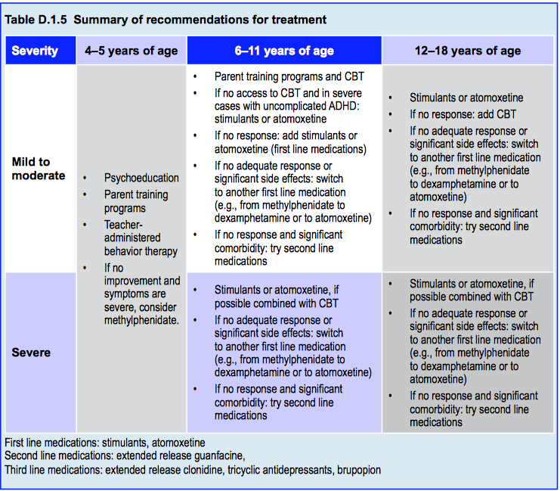
ADHD
Summary of Recommendations for Treatment

Slide 37
Medication:
ADHD
ADHD
When to Refer?
If no response and severe impairment after pharmacological treatment combined with behavioral approaches
  Re-evaluate diagnosis and co-morbidity
  Check for undetected social adversity or abuse
If still no response after 6 months consult with specialist

Slide 38
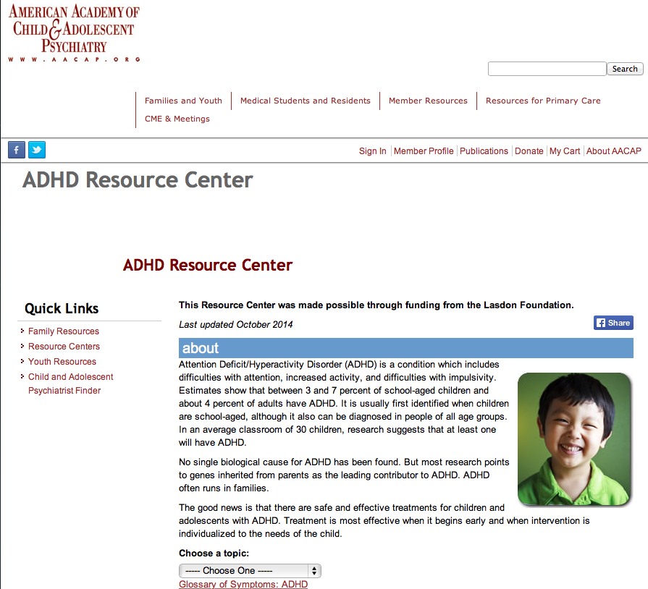
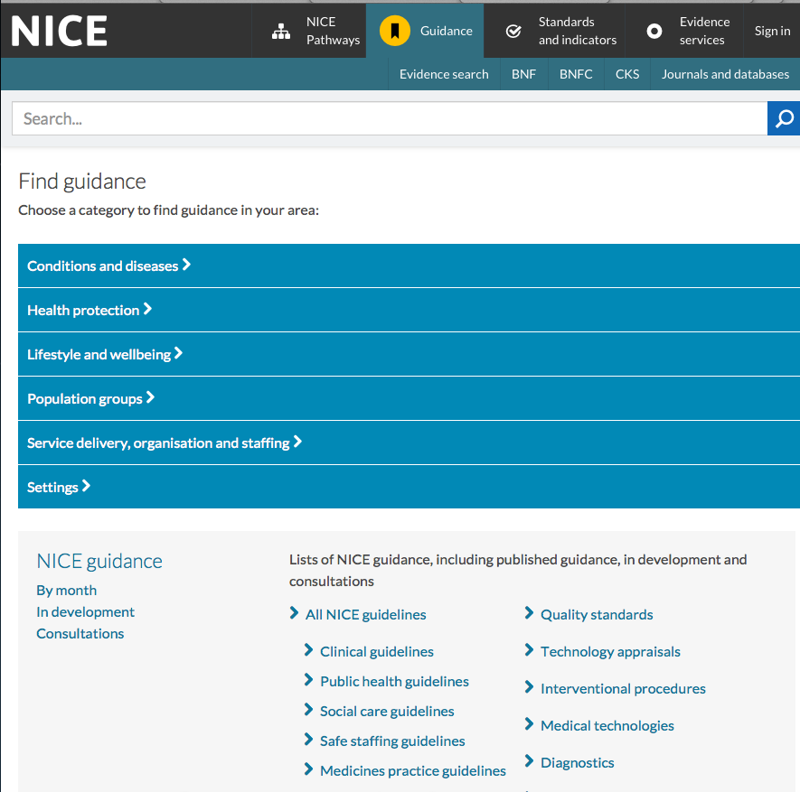
Medication:
ADHD
ADHD
Further Resources
AACAP ADHD Resource Center
http://www.aacap.org/AACAP/Families_and_Youth/Resource
Centers/ADHD_Resource_Center/Home.aspx
NICE Guideline, Tools,
and Resources
http://www.nice.org.uk/guidance/cg72/resources
Notes:
--American Academy of Child and Adolescent Psychiatry has an excellent ADHD Resource center

Slide 39

Medication:
ADHD
ADHD
Thank You!
Notes:
--American Academy of Child and Adolescent Psychiatry has an excellent ADHD Resource center

