Slide 1
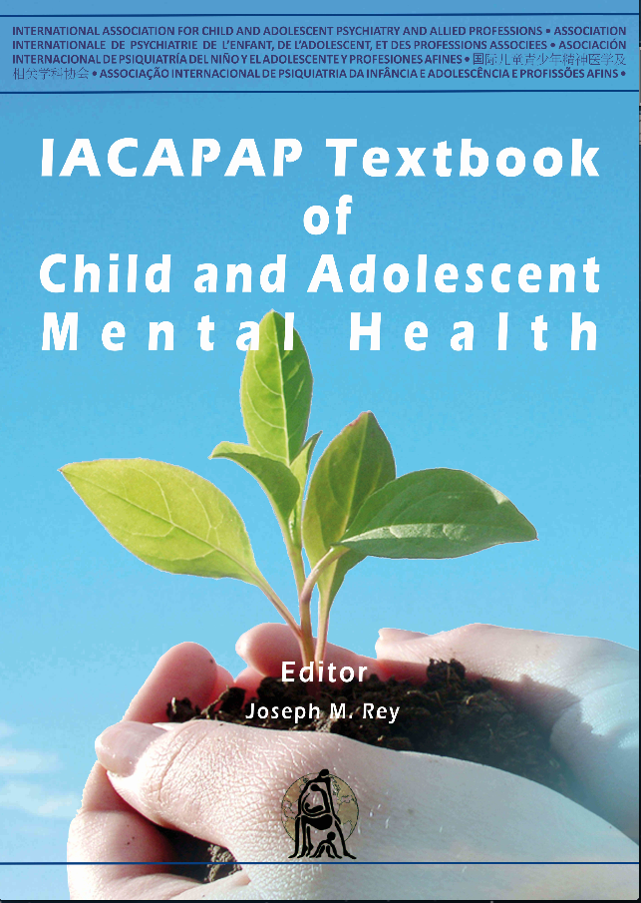
MOOD DISORDERS
Chapter E3
DISRUPTIVE MOOD DYSREGULATION DISORDER
Florian Daniel Zepf, Caroline Sarah Biskup, Martin Holtmann, & Kevin Runions
TS
Companion Powerpoint Presentation
Adapted by Julie Chilton

Slide 2
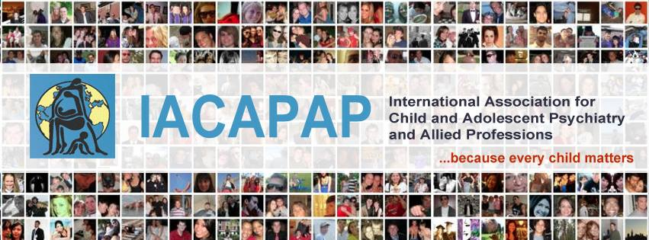
The “IACAPAP Textbook of Child and Adolescent Mental Health” is available at the IACAPAP website http://iacapap.org/iacapap-textbook-of-child-and-adolescent-mental-health Please note that this book and its companion PowerPoint are: · Free and no registration is required to read or download it · This is an open-access publication under the Creative Commons Attribution Non- commercial License. According to this, use, distribution and reproduction in any medium are allowed without prior permission provided the original work is properly cited and the use is non-commercial.

Slide 3

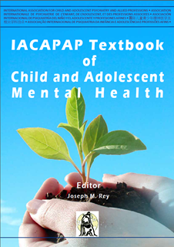
Disruptive Mood Dysregulation Disorder Outline
Clinical Presentation & Diagnosis
Epidemiology
Course and Outcome
Assessment & Differential Diagnosis
Etiology & Risk Factors
Treatment
Notes:
By the end of this presentation, you should understand the following about Disruptive Mood Dysregulation Disorder in children and adolescents

Slide 4
Disruptive Mood Dysregulation Disorder Introduction
“DMDD”
Temper outbursts with chronic irritability
New, controversial diagnosis in DSM-5
Introduced to address pediatric bipolar disorder controversy
Other interpretations:
Severe Mood Dysregulation (SMD), Leibenluft, 2003, minus hyperarousal
Child Behavior Checklist Dysregulation Profile
DMDD vs ADHD vs Oppositional Defiant DIsorder vs Bipolar Disorder
Distinct etiology
Different neurobiology
Divergent developmental outcomes
All 4 have irritability and temper outbursts
Debate about clinical validity and usefulness
Notes:
Although irritability and temper outbursts are by no means uncommon in the young, their chronicity and intensity beyond developmental norms can prove challenging for patients, parents, and those who work with children. Severe irritability is one of the most common reasons for presentation to mental health services (Stringaris, 2011), and emotional and behavioral dysregulation are commonly observed amongst young people referred to services. These symptoms can be present in a range of disorders including oppositional defiant disorder (ODD), attention-deficit/hyperactivity disorder (ADHD), bipolar and depressive disorders (Bertocci et al, 2014; Brotman et al, 2006; Stringaris & Goodman, 2009). The new diagnostic category of disruptive mood dysregulation disorder (DMDD) was introduced in DSM-5 to address this problem. Although DMDD has been controversial as indexed by discussions in the media as well as among clinicians and researchers, a growing body of evidence suggests that this condition has a distinct etiology, divergent developmental outcomes, and differences in neurobiology from pediatric bipolar disorder, ADHD, and ODD.
DMDD as a diagnostic category was introduced after controversy about the diagnosis of pediatric bipolar disorder that had led to the identification of the syndrome, initially called “severe mood dysregulation”. Severe mood dysregulation as a clinical phenotype was described by Leibenluft et al in 2003, who defined it as chronic (non-episodic) and severe irritability and hyperarousal without the euphoric and grandiose characteristics that are the hallmark of bipolar disorder. DMDD was introduced in DSM-5 to make available a diagnosis that would account for severe temper outbursts out of proportion to the context, that are not consistent with the child’s developmental level, and that occur on average three or more times per week. A chart review study noted that patients with DMDD had a median of 4 temper tantrums per week (Tufan et al, 2016). Between tantrums, the child must show chronic irritability—angry outbursts, annoyance, and touchiness (Stringaris, 2011). Table E.3.1 summarizes the diagnostic criteria for DMDD, included in the depressive disorders chapter in DSM-5.

Slide 5
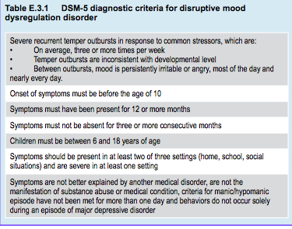
Notes:
Unlike children and adolescents with bipolar disorder—who present with distinct periods of depressed mood and of mania or hypomania—patients with DMDD do not show well defined episodes. According to DSM-5, an episode is characterized by a distinct period of mood change distinguishable from the persons’ usual mood, lasting at least one week for mania or four days for hypomania. These discrete episodes are separated by periods of euthymia or sub-syndromal symptoms. DMDD, on the contrary, requires persistency of the abnormal mood state. According to DSM-5, a diagnosis of DMDD cannot be made before 6 or after 10 years of age. Prior to the age of 6 temper outbursts are normal (Wakschlag et al, 2012) and the boundaries of clinically concerning temper tantrums are unclear. Importantly, DSM-5 criteria indicate that a DMDD diagnosis cannot be made concurrently with ODD, bipolar disorder, or intermittent explosive disorder.

Slide 6
Disruptive Mood Dysregulation Disorder Severe Mood Dysregulation
“SMD” described by Ellen Leibenluft et al in 2003
Chronic (non-episodic) and severe irritability and hyperarousal without euphoria and grandiosity of bipolar disorder
More studies on SMD than DMDD
Upper age limit of onset for diagnosis of SMD is 12 vs 10 in DMDD
SMD diagnosis requires symptoms of hyperarousal , DMDD does not
Increased risk for later depressive and anxiety disorders in adulthood but not bipolar disorder
Notes:
DMDD as a diagnostic category was introduced after controversy about the diagnosis of pediatric bipolar disorder that had led to the identification of the syndrome, initially called “severe mood dysregulation”. Severe mood dysregulation as a clinical phenotype was described by Leibenluft et al in 2003, who defined it as chronic (non-episodic) and severe irritability and hyperarousal without the euphoric and grandiose characteristics that are the hallmark of bipolar disorder. DMDD was introduced in DSM-5 to make available a diagnosis that would account for severe temper outbursts out of proportion to the context, that are not consistent with the child’s developmental level, and that occur on average three or more times per week. A chart review study noted that patients with DMDD had a median of 4 temper tantrums per week (Tufan et al, 2016). Between tantrums, the child must show chronic irritability—angry outbursts, annoyance, and touchiness (Stringaris, 2011). Table E.3.1 summarizes the diagnostic criteria for DMDD, included in the depressive disorders chapter in DSM-5.

Slide 7
Disruptive Mood Dysregulation Disorder Child Behavior Checklist Dysregulation Profile
Captures broad overlap between SMD and DMDD behaviors
Severe behavioral and affective dysregulation:
Irritability, aggression
Mood instability and “affective storms”
Hyperarousal
Extreme scores on CBCL syndrome scales:
“anxious/depressed”
“attention problems”
“aggressive behavior”
Epidemiology:
1-2% in epidemiological samples from multiple studies
6-7% in child psychiatric clinical samples (Holtman et al, 2008)
13-20% in children with ADHD (Holtman et al, 2008)
Increased risk for later substance use, conduct and mood disorders, suicidal ideation and attempts, but not for bipolar disorder
Notes:
Some researchers have used the Child Behavior Checklist (CBCL) (Achenbach, 1991) to capture a phenotype showing broad overlap between the behaviors observed in DMDD and severe mood dysregulation (e.g., Diler et al, 2009; Holtmann et al, 2008; Volk & Todd, 2007). This CBCL “dysregulation” profile encapsulates a mixed phenotype of severe behavioral and affective dysregulation, including irritability, aggression, “affective storms”, hyperarousal, and mood instability. This profile is characterized by simultaneous extreme scores on the CBCL syndrome scales “anxious/depressed”, “attention problems”, and “aggressive behavior”. Much of our current understanding of DMDD relies on inference from research on this construct

Slide 8
Disruptive Mood Dysregulation Disorder Epidemiology
97% of SMD youths met criteria for DMDD, remainder failed to meet criteria only due to age of onset
8% 3-month DMDD prevalence in 6-year-old American children (Dougherty et al, 2014)
Only 1% preschool and school age cohorts qualified when duration and frequency criterion applied (Copeland et al, 2013)
Notes:
Most of what we know about DMDD has been inferred from research on severe mood dysregulation, although the upper age limit placed on its onset differs between DMDD (10 years) and severe mood dysregulation (12 years). A longitudinal study on severe mood dysregulation indicated that 97% of youths who met diagnostic criteria for this condition also met criteria for DMDD; the remainder only failed to meet the criteria due to an age of onset of 10 or 11 years (Deveney et al, 2015). Moreover, a diagnosis of severe mood dysregulation requires symptoms of hyperarousal, whereas DMDD does not, with the proviso that clinicians can assign a concurrent diagnosis of ADHD if warranted.
A 3-month DMDD prevalence of 8.2% was observed in 6-year-old American children with no sex or ethnicity differences (Dougherty et al, 2014). A study by Copeland et al (2013) illustrates the prevalence of DMDD symptomology in a large epidemiological sample including preschool and school age cohorts. Among school age children, nearly half had shown severe temper outbursts during the 3 months prior to assessment. Applying the frequency criterion reduced the prevalence to 6-7%; applying the duration criterion dropped the rate to 1.5-2.8%. When all DMDD criteria were applied, prevalence was about 1%.

Slide 9
Disruptive Mood Dysregulation Disorder Course and Outcome
80% children with DMDD at age 9 also met criteria at age 6
Childhood DMDD diagnosis has increased risk of:
Depressive disorders and ADHD
Disruptive behavior disorder symptoms
Peer relationship problems
Peer exclusion and victimization
Relational aggression
Adolescent DMDD diagnosis has increased risk of:
Serious illness
Sexually transmitted diseases
Other non-substance related psychiatric disorders
Nicotine use
Police contact
Poverty
Not achieving a high school diploma and no college attendance
Patients with DMDD or SMD do not show later increased risk for
bipolar but do have an increased risk for depressive disorders
Notes:
Few studies have examined the stability of DMDD over time. Stability may be higher in childhood than adolescence: over 80% of children who meet criteria for DMDD at age 9 also met criteria when they were 6 years old (Dougherty et al, 2016). By contrast, a study of 200 adolescents diagnosed with severe mood dysregulation found that less than half met criteria at follow-up (Deveney et al, 2015).
Children diagnosed with DMDD at age 6 are at increased risk for depressive disorders and ADHD at age 9; the risk of disruptive behavior disorder symptoms was also elevated for these children (Doughterty et al, 2016). Childhood DMDD status also predicts subsequent peer relationship problems, increased peer exclusion and victimization (i.e., being bullied), and more use of relational aggression (Dougherty et al, 2016). In later childhood, DMDD diagnosis in 10 to 16 year olds predicted a range of subsequent problems in young adulthood (Copeland et al, 2014). Compared to non-cases and a psychiatric comparison group, those who met criteria for DMDD were at greater risk as young adults for serious illness, sexually transmitted diseases, other non-substance-related psychiatric disorders, nicotine use, police contact, poverty, not achieving a high school diploma, and no college attendance.
Although the DMDD diagnosis arose out of research on bipolar disorder (see Assessment and Differential Diagnosis, below) patients with DMDD or severe mood dysregulation do not show increased risk for later bipolar illness (Brotman et al, 2006; Stringaris et al, 2009), but have an increased risk of depressive disorder (Krieger et al, 2013)—thus the classification of DMDD in the depressive disorders chapter in DSM-5. This is also supported by studies concluding that children with severe temper outbursts seldom show symptoms of bipolar disorder (Roy et al, 2013, Mikita & Stringaris, 2013). Similarly, severe mood dysregulation is associated with depressive and anxiety symptoms in later adulthood (Brotman et al, 2006; Stringaris et al, 2009). Bipolar disorder is found less frequently in families of children with severe mood dysregulation than in families of children with bipolar disorder in both community and clinical populations (Brotman et al, 2007; Leibenluft, 2011). A 2-year follow-up of youths with severe mood dysregulation showed that they had lower rates of manic, hypomanic or mixed episodes than patients with bipolar disorder (Stringaris et al, 2010).
Long-term follow-up of children captured by the CBCL “dysregula- tion” profile suggests that young adults with a positive CBCL “dysregula- tion” profile in childhood are at increased risk for substance use, conduct and mood disorders, suicidal ideation, and suicide attempts but not for bipolar disorder. In addition, they showed a marked impairment in over- all functioning (Althoff et al, 2010; Holtmann et al, 2011a). The CBCL “dysregulation” profile may be a valuable tool to identify patients with severe mood problems. High scores may indicate poor outcomes, such as substance use, suicidality, and functional impairment (Holtmann et al, 2011; Jucksch et al, 2011).

Slide 10
Disruptive Mood Dysregulation Disorder Assessment & Differential Diagnosis
Irritability and temper outbursts common to DMDD, ADHD, oppositional defiant disorder, conduct disorder, bipolar
Overdiagnosis of bipolar disorder between 1993-2003 in US
Doubled in adults
Increased 40 times in people under 20
General consensus: bipolar diagnosis requires distinct manic or hypomanic episodes
Notes:
As noted in the introduction, the core symptoms of DMDD – irritability and temper outbursts – are often present in individuals suffering from bipolar disorder, ADHD, and ODD among others. Moreover, DMDD commonly overlaps with other disorders. For example, Copeland et al (2013) noted a 63 to 92% overlap with other diagnoses; Fristad and her colleagues (2016) highlighted the high overlap of baseline demographic and clinical variables with Bipolar Disorder Not Otherwise Specified. Thus assessment and differential diagnosis of children with DMDD is difficult.
A chart review found an average age of onset of 4.9 years (Tufan et al, 2016). This study also provides insights into the diagnostic challenges: consensus could not be reached in more than 20% of patients. The more common reasons for this were whether symptoms occurred in more than one setting and whether there was anger or other negative moods between tantrums. Other sources of disagreement related to the frequency of tantrums, tantrum severity, and duration of symptoms. Holtmann and his colleagues (2011b) established that a 5-item subset from the Strengths & Difficulties Questionnaire could be a valid screening measure.
The assignment of a bipolar disorder diagnosis to children and adolescents with chronic irritability but without distinct episodes of mania has been controversial. The debate is not only academic: broadening the diagnostic construct resulted in dramatic changes in clinical practice. For example, between 1993 and 2003 the number of adults diagnosed with bipolar disorder in the US doubled, but increased 40 times in people younger than 20 years (Blader & Carlson, 2007; Moreno et al, 2007); this shift was accompanied by a large increase in the prescription of antipsychotic drugs to youth (Olfson et al, 2006). Data suggest that widening of the bipolar construct in the US was the explanation: for example, James et al (2014) noted a 70-fold difference in hospital discharges for bipolar disorder in the US and the UK, indicating different diagnostic practices.
According to the guidelines of the British National Institute for Health and Clinical Excellence, a diagnosis of bipolar disorder in children should only be made if the patient has a history of manic or hypomanic episodes in line with relevant diagnostic criteria, including duration and frequency of such episodes (Baroni et al, 2009). That is, bipolar disorder should not be diagnosed in the absence of episodes characterized by a distinct change in mood and concurrent changes in behavior and cognition. The traditional view, and the view represented in DSM-5, is that bipolar disorder can occur in pre-pubertal children but very rarely, becoming increasingly prevalent during adolescence, and that symptoms in the young are largely the same as in adults.
The presence of irritability and temper outburst have led some researchers and clinicians to argue that there is no clear demarcation between DMDD, ODD and conduct disorder (Axelson, 2013). Proponents of this view maintain that bipolar disorder is often misdiagnosed as, or co-morbid with, ADHD (Biederman et al, 1998). ADHD does seem to have a considerable symptom overlap with bipolar disorder in children and adolescents as can be seen in Figure E.3.1 (Zepf, 2009), though irritability in bipolar disorder is episodic, unlike in DMDD where it is chronic.
Lochman et al (2015) argue that ICD-11 should not incorporate the DMDD category, proposing instead to make a diagnosis of ODD and add a specifier indicating chronic irritability or anger instead. This argument is bolstered by findings that 92% of children aged 6-12 years in a general population sample who met DMDD criteria also met criteria for ODD, and 66% of those with ODD also had DMDD symptoms (Mayes et al, 2016). Deveney et al (2015) reported that over 80% of their sample of adolescents meeting criteria for severe mood dysregulation also met criteria for ODD or ADHD. However, other data indicate that DMDD and ODD show a more modest overlap (55%) and that DMDD predicts impairment over and above that due to ODD (Dougherty et al, 2014).

Slide 11
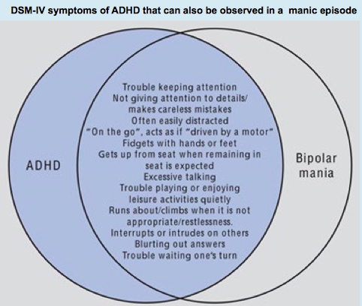

Slide 12
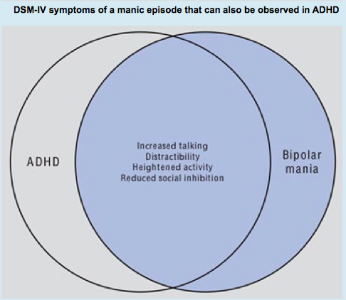

Slide 13
Disruptive Mood Dysregulation Disorder Etiology & Risk Factors
Developmental predictors of DMDD at age 6 (Dougherty et al, 2014):
Parental lifetime substance use
Temperamental “surgency”
High levels of activity
Reward seeking
Low shyness
Impulsivity
Chart review showing ¾ of DMDD patients had parents with mental health issues:
Major depressive disorders
ADHD
Anxiety disorders
Notes:
The literature on developmental predictors of DMDD is in its infancy. Dougherty et al (2014) examined at age 3 predictors of DMDD at age 6. They noted that only temperamental “surgency” (a construct reflecting high levels of activity, reward seeking, low shyness, and impulsivity) and parental lifetime substance use disorder predicted DMDD status at age 6. In one study, participants with a CBCL “dysregulation” phenotype exhibited an increase in C-reactive protein and albumin concentrations, raising the possibility of an inflammatory diathesis (Holtmann et al, 2013).
To date, few studies have been conducted shing light on family or other social or ecological factors that might contribute to the development of DMDD. The chart review by Tufan and colleagues (2016) indicated that over a three quarter of patients with DMDD had family histories involving parental mental health problems, including major depressive disorders, ADHD and anxiety disorder (56%, 25%, and 17% respectively). Although maternal depression has been linked to irritability in children with ODD (Krieger et al, 2013), no studies have found evidence for a role in DMDD of parental depression or other parental psychopathology (e.g., Axelson et al, 2012). Parents of children with DMDD have been shown to be more hostile and critical in their interactions with their children, but this may reflect bidirectional parent-child processes (Dougherty et al, 2014). A history of lifetime substance use disorder has also been implicated. Compared with children diagnosed with bipolar disorder not otherwise specified, children with DMDD are less likely to have a parent with bipolar disorder (Fristad et al, 2016).
Interpersonal trauma and exposure to traumatic events are widely acknowledged as being associated with affective dysregulation generally (Dvir et al, 2014), but to date no studies have examined trauma or related events including abuse and neglect as risk factors for DMDD. Child maltreatment and physical abuse are known risk factors for the sorts of affective processing biases observed with severe mood dysregulation and DMDD (see next section) (Leibenluft & Stoddard, 2013). However, empirical studies have not yet focused on whether these factors are particularly implicated in DMDD. Clearly, further research is needed to establish a better picture of the etiology of DMDD.
Social-Affective and Cognitive Neuroscience
There is a burgeoning body of research examining social and emotional information processing and emotion regulation and the underlying neurobiology of severe mood dysregulation, particularly in comparison with other diagnoses such as bipolar disorder. Much of this research has focused on response to emotion-laden stimuli, primarily to the human face. Severe mood dysregulation and bipolar disorder share common social cognitive deficits in processing affective information from the human face, showing less accuracy in labelling expressions and less sensitivity in facial emotion recognition relative to healthy controls. There is some evidence of biased processing of threatening faces in particular (Hommer et al, 2014). Functional magnetic resonance imaging research with severe mood dysregulation patients shows differential neural activation of the posterior cingulate cortex, posterior insula, and inferior parietal lobe in relation to fearful faces (Thomas et al, 2013). Future research need to examine whether these biases are specific to DMDD/severe mood dysregulation or reflect co- morbid psychopathology such as ODD.
Compared to individuals with bipolar disorder, those with DMDD show diminished cognitive flexibility as assessed with a reversal learning task (Adleman et al, 2012), and poor motor inhibition (Deveney et al, 2012). These characteristics are shared with patients with ADHD, however, and this overlap may account for these features (Uran & Kiliç, 2015).
In summary, at this stage it can be concluded that underlying brain mechanisms related to the symptomatology of severe mood dysregulation are different between patients with severe mood dysregulation, bipolar disorder, and healthy people, which may be of importance to develop pharmacological interventions.

Slide 14
Disruptive Mood Dysregulation Disorder Social-Affective and Cognitive Neuroscience
In SMD and bipolar disorder vs healthy controls:
Less accuracy in labelling expressions
Less sensitivity in facial emotion recognition
Biased processing of threatening faces
(Hommer et al 2014)
Differential neural activation on FMRI of patients with SMD shown fearful faces:
Posterior cingulate cortex
Posterior insula
Inferior parietal lobe
(Thomas et al, 2013)
Notes:
There is a burgeoning body of research examining social and emotional information processing and emotion regulation and the underlying neurobiology of severe mood dysregulation, particularly in comparison with other diagnoses such as bipolar disorder. Much of this research has focused on response to emotion-laden stimuli, primarily to the human face. Severe mood dysregulation and bipolar disorder share common social cognitive deficits in processing affective information from the human face, showing less accuracy in labelling expressions and less sensitivity in facial emotion recognition relative to healthy controls. There is some evidence of biased processing of threatening faces in particular (Hommer et al, 2014). Functional magnetic resonance imaging research with severe mood dysregulation patients shows differential neural activation of the posterior cingulate cortex, posterior insula, and inferior parietal lobe in relation to fearful faces (Thomas et al, 2013). Future research need to examine whether these biases are specific to DMDD/severe mood dysregulation or reflect co- morbid psychopathology such as ODD.
Compared to individuals with bipolar disorder, those with DMDD show diminished cognitive flexibility as assessed with a reversal learning task (Adleman et al, 2012), and poor motor inhibition (Deveney et al, 2012). These characteristics are shared with patients with ADHD, however, and this overlap may account for these features (Uran & Kiliç, 2015).
In summary, at this stage it can be concluded that underlying brain mechanisms related to the symptomatology of severe mood dysregulation are different between patients with severe mood dysregulation, bipolar disorder, and healthy people, which may be of importance to develop pharmacological interventions.

Slide 15
Disruptive Mood Dysregulation Disorder Treatment
Few trials to inform clinical practice
Most recommendations from studies with SMD, ODD and depression
Younger children with emotion dysregulation more sensitive to changed parenting than children without
Possible off-label psychopharmacological options: stimulants (methylphenidate), antidepressants, antipsychotics (risperdal), mood stabilizers (divalproex)
Psychoeducation
Collaboration with teachers
Strategies for dealing with crises
Identification of potential stressors and triggers
Parenting programs
Family therapy
*rule out abuse and neglect
Notes:
Because DMDD is such a recent inclusion in the taxonomy, there are few clinical trials that could inform clinical practice. Therefore, most of the management recommendations are extrapolated from studies dealing with related disorders such as severe mood dysregulation, ODD, and depression (Roy et al, 2014). `
Scott and O’Connor (2012) investigated the effects of parent training and cognitive behavior therapy in children aged 4-6 years presenting with the emotion dysregulation (defined as irritable and/or hurtful) subtypes of ODD as compared to patients with ODD without such a profile. Although the children were too young to meet diagnostic criteria for either severe mood dysregulation or DMDD, the study showed that young children with emotion dysregulation were more sensitive to changed parenting and showed stronger treatment effects than children without these symptoms.
Given the high comorbidity of DMDD with ADHD, stimulants have been studied as a possible treatment (Posner et al, 2014). Medications that improve irritability and depressed mood may be valuable – all used “off label”. Second generation antipsychotics such as risperidone have also been used. A double-blind RCT of lithium treatment did not reduce symptoms in hospitalized patients with severe mood dysregulation (Dickstein et al, 2009). Krieger and colleagues (2011) reported a significant reduction in irritability in an open-label study of risperidone. Carlson et al (2010) found similar results. This is consistent with the widely known finding that risperidone can reduce aggressive behavior and irritability in the young. However, these early findings should be seen with extreme caution considering the potentially serious side effects of antipsychotics in the young and the fact that they do not specifically refer to patients with DMDD. Preliminary studies suggest that adolescents with ODD/CD and symptoms suggestive of DMDD show a reduction of symptoms when treated with divalproex (Donovan et al, 2000), a commonly used treatment for bipolar disorder. Discussion with parents and patients as well as careful monitoring of side effects is essential when prescribing these medications.
Educational approaches are highly relevant. Clinicians, teachers and parents need to work closely together to address and meet these patients’ special needs (e.g., consistency, classroom support, more time to complete school tests, etc.). Teachers should also be made aware of the adverse effects of medication if it is prescribed. Patients and families should receive education about the disorder, comorbid symptoms and related impairments, as well as strategies for managing them. Finally, changes in lifestyle can be addressed together with the help of allied health professionals. Such changes may include strategies for dealing with crises and identifying potential stressors and triggers. A plan to manage emergencies (e.g., suicidal behavior, extreme loss of control) needs to be put in place. Moreover, parenting programs and family therapy need to be considered as many of these children come from problematic families with poor parenting and communication skills; often parents themselves suffer from psychiatric disorders. In that case a referral should be considered. This is an ideal situation. However, in many countries these resources won’t be available; clinicians may need to rely on psychoeducation, school teachers, extended family and other supports.

Slide 16
Disruptive Mood Dysregulation Disorder Conclusion: Key Messages
Useful diagnosis for children with severe, non-episodic irritability
Irritability likely related to the depression dimension
Different from bipolar disorder in longitudinal course, family history, and neuropsychological performance
Diagnose pediatric bipolar disorder only when discrete episodes of mania
Limited evidence to guide treatment

Slide 17

Disruptive Mood Dysregulation Disorder Thank You!

